Slide 1
Care Coordination Workgroup – 4/21/2025 Assistive Technology for Daily Living

Slide 2
Introduction to Assistive Technology
Global Impact and Market Growth
The assistive technology market is rapidly growing, with global revenue projected to exceed $30 billion by 2027, driven by innovations in smart technology and healthcare advancements.
Definition and Scope
Assistive technology refers to devices or systems that help individuals with disabilities perform tasks that might otherwise be difficult or impossible.
Importance in Daily Living
Assistive technologies play a crucial role in increasing the independence and quality of life for people with disabilities, enabling them to participate fully in daily activities.

Slide 3
Assistive Technology for Communication
Text to Speech Devices
Devices that convert typed text into spoken words allowing individuals with speech impairments to communicate effectively.
Augmentative and Alternative Communication Devices
AAC devices use symbols comma words comma or pictures to help nonverbal individuals communicate through alternative
Sign Language Interpreters
Technology based solutions that facilitate communication between individuals who are deaf and those who do not know sign language he

Slide 4
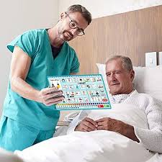
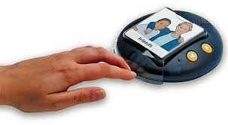
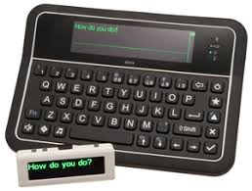
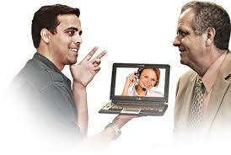
Examples of Communication Tools

Slide 5
Assistive Technology for Daily Living
Smart Home Devices
Smart home devices like voice activated assistance (Amazon Alexa) will allow individuals with physical impairments to control lights comma thermostats comma and appliances easily
Adapted Utensils
Ergonomically designed utensils with specially shaped grips enable individuals with limited dexterity or motor control to eat independently
Medication Management
Automated pill dispensers and reminder apps help people manage their medications effectively and ensure adherence to prescribed schedules.

Slide 6
Smart Home Tech Examples

Slide 7
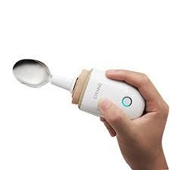
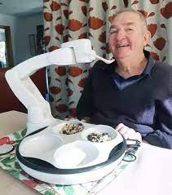
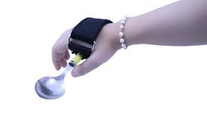
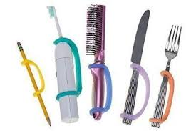
Examples of Adaptive Feeding tools

Slide 8
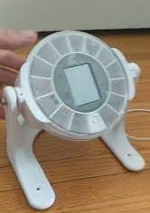
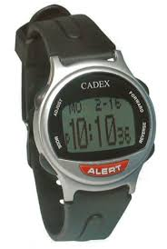
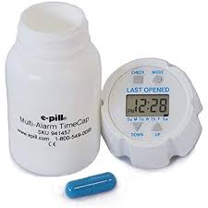
Examples of Med Management

Slide 9
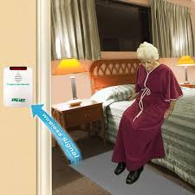
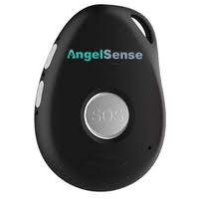
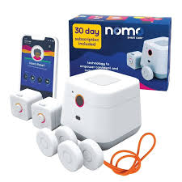
Examples of Fall Protection

Slide 10
Assistive Technology for Sensory Needs
Hearing Aids
Devices that amplify sound for individuals with hearing impairments comma improving their ability to interact with the environment and communicate
Visual Aids
Assistive technologies such as screen readers and magnifiers help individuals with visual impairments access information and navigate their surroundings
Tactile Devices
Innovations such as Braille displays, and tactile feedback devices enable individuals with vision impairments to read and interact with digital content

Slide 11
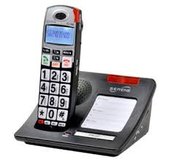
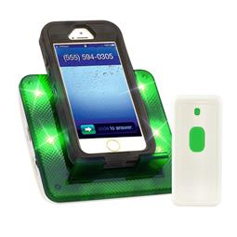
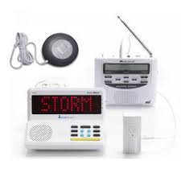
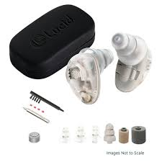
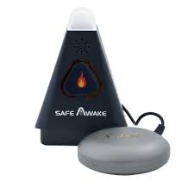
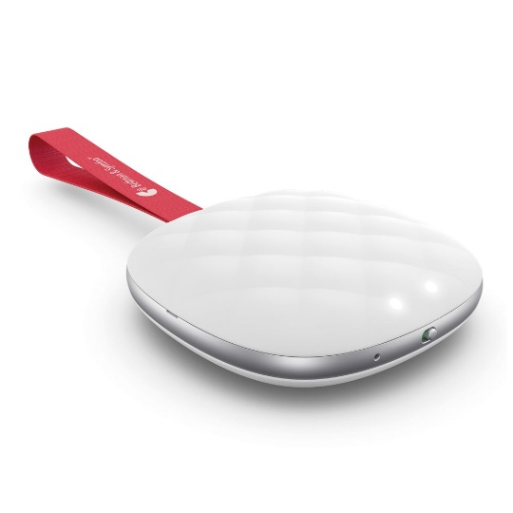
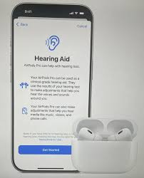
Examples of Tech for Hearing Loss

Slide 12
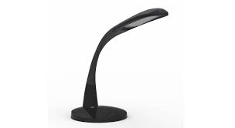
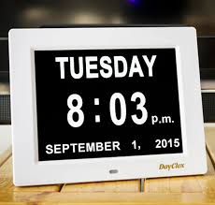
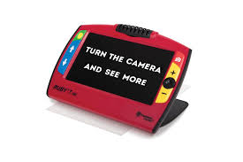
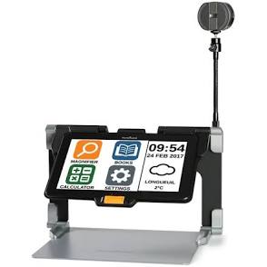
Examples of Tech for Vision Loss

Slide 13
Impact of assistive technologies
Increased Independence
Assistive technologies empower individuals to perform tasks autonomously, reducing reliance on caregivers and fostering independence
Enhanced quality of life
By enabling access to education, work, and social activities, assistive technology devices contribute to a more fulfilling and inclusive life for individuals with
Social Inclusion
These technologies enable people with disabilities to participate in society, improve being inclusion in various settings like workplaces and schools
Notes:
Improving lives and society

Slide 14
Challenges and Future Trends
Affordability and Access
High costs and unequal distribution of assistive devices limit access for many individuals, particularly in low-income regions
Innovations in AI and IoT
Emerging technologies like AI driven devices and internet of things integration promise smarter, more adaptable assistive technology solutions
Ethical and Legal Considerations
The use of advanced assistive technologies raises questions around data privacy, ethical use, and the need for regulatory oversight

Slide 15
Conclusion
Empowering Lives
Assistive technology will continue to play a pivotal role in improving the independence and quality of life for individuals with disabilities.
Ongoing Innovations
Advances in AI, IoT, and personalized devices will create more adaptable and intelligent solutions for users.
Accessibility for All
The focus must remain on making these technologies affordable and accessible to everyone, regardless of economic or geographic barriers

Slide 16
MN STAR Program
System of Technology to Achieve Results (STAR)
Minnesota’s federally funded Assistive Technology Act Program
Housed within the MN Department of Administration
Providing services to ALL MINNESOTANS
No proof of disability required.
There is no cost for the STAR Program services

Slide 17
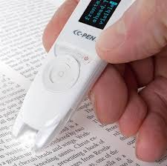
More STAR Facts
STAR services include:
Device demonstrations
Device short-term loans
Open-Ended loans
Information and assistance
Partner with state agencies, community organizations and professionals

Slide 18
MN.AT4ALL.COM

Slide 19
Thank You!
Please reach out to us at STAR for any Assistive Technology related questions!
https://mn.gov/admin/star/
https://mn.at4all.com/
Star.program@state.mn.us
651-201-2640

