Slide 1
Bridgeview Tuesdays February 2025
Janet Siegel, Ruth Finch, & Partner Relations Team
02/11/2025

Slide 2
Agenda
Welcome and Introductions
Changes for 2025
CFSS Overview
Questions
Notes:
Due to time constraints, please hold your questions until we complete the presentation.

Slide 3
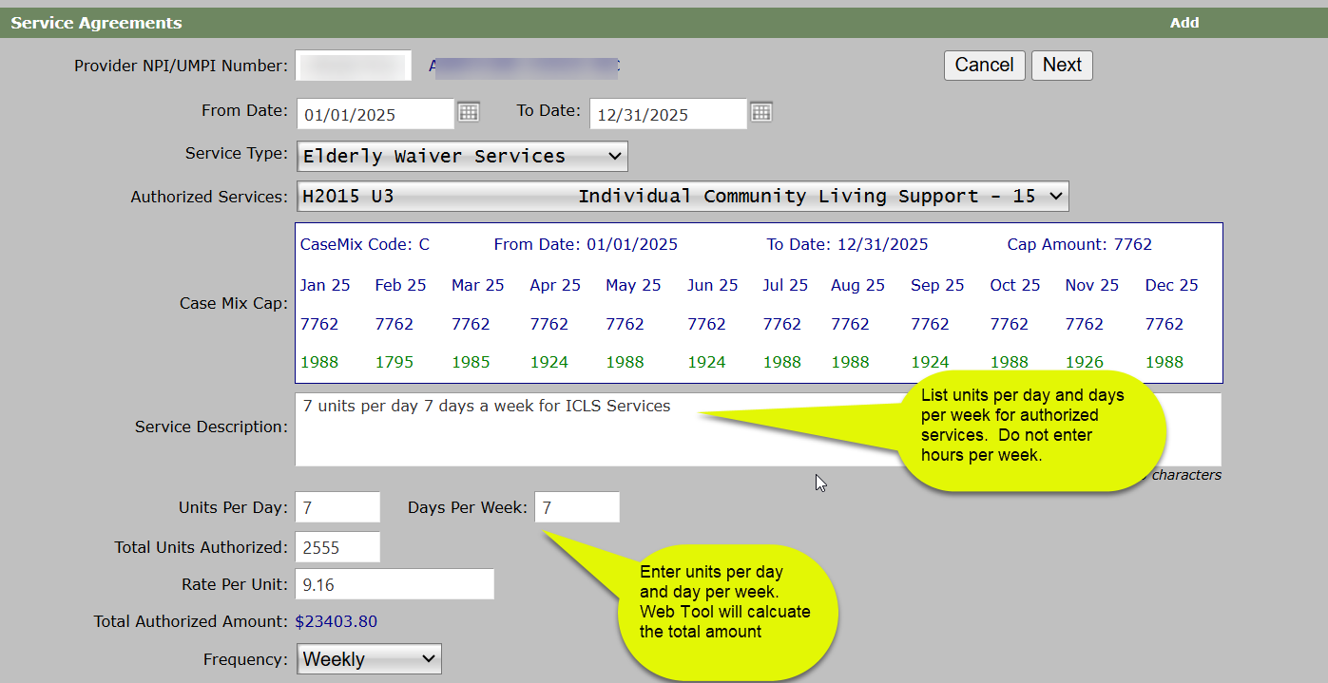
Bridgeview changes effective 01/30/2025
Notes:
H0215 U3 Changes: Enter all authorized services using the units per day and days per week. Do not enter hours per week and then the total amount.

Slide 4
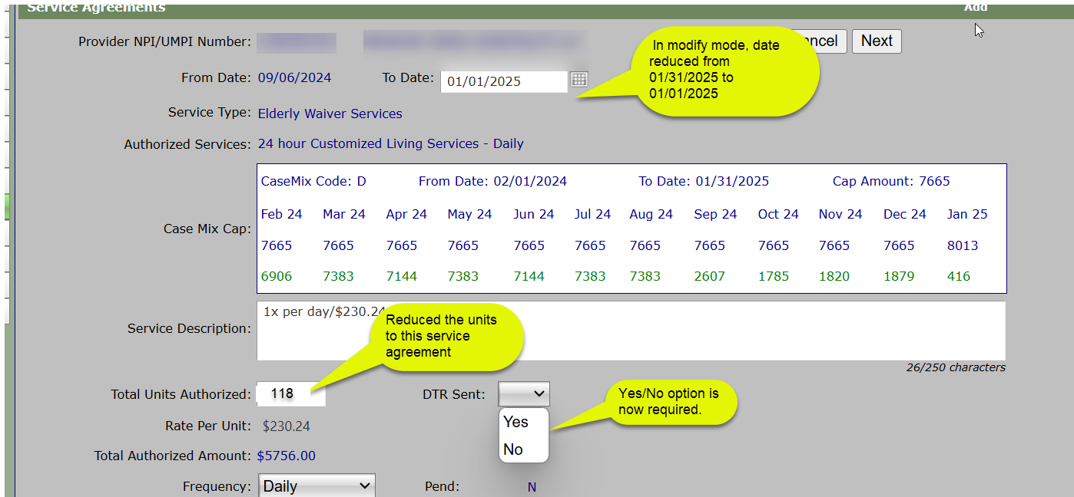
Bridgeview changes effective 01/30/2025
Notes:
DTR (Denied, Terminate, Reduction) option when modifying an existing service agreement: When modifying an existing services agreement and reducing the “TO Date” and “Total Units Authorized”, a new requirement will display requesting you to select a “Yes”/” No” option if a DTR letter was sent. This informational only, but is also a prompt to remind you that you must complete a DTR form when reducing the members dates span and or units.

Slide 5
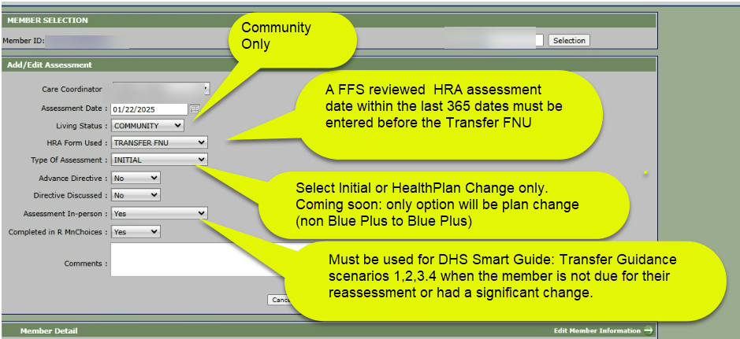
Bridgeview changes effective 01/30/2025
Notes:
Assessment Entry: NEW Transfer FNU option: Must enter “Fee for Service/Reviewed HRA” entry in Bridgeview with assessment activity within the last 365 days before entering the Transfer FNU assessment date. Completed in MnCHOICES must select “yes”.

Slide 6
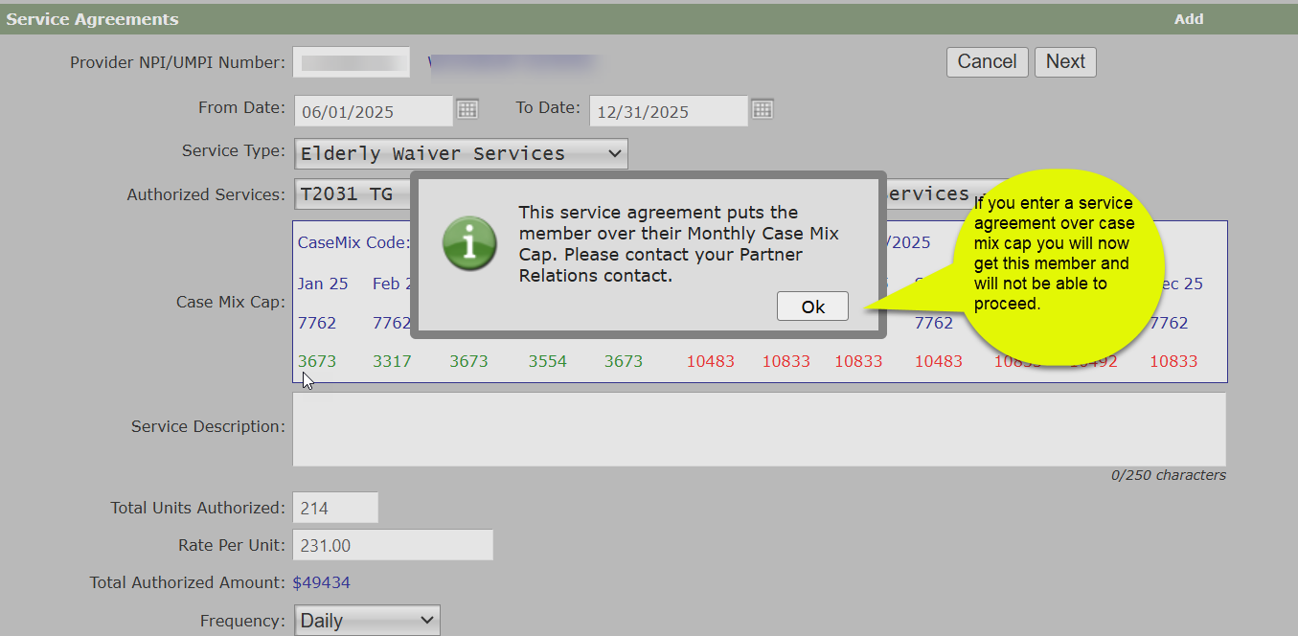
Bridgeview changes Coming soon!!
Notes:
Case Mix Cap Amounts: When entering a service agreement that accumulates towards the member monthly Case Mix Cap amounts any overage (amount turns red) will stop you from continuing the entry.
You will get a message to contact your Partner Relations team for questions.

Slide 7
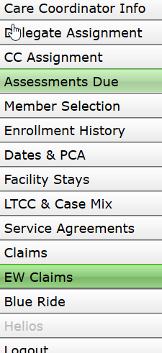
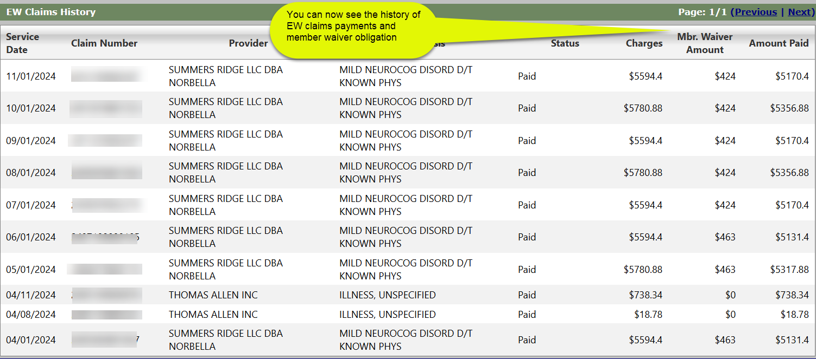
Bridgeview changes Coming soon!!

Slide 8
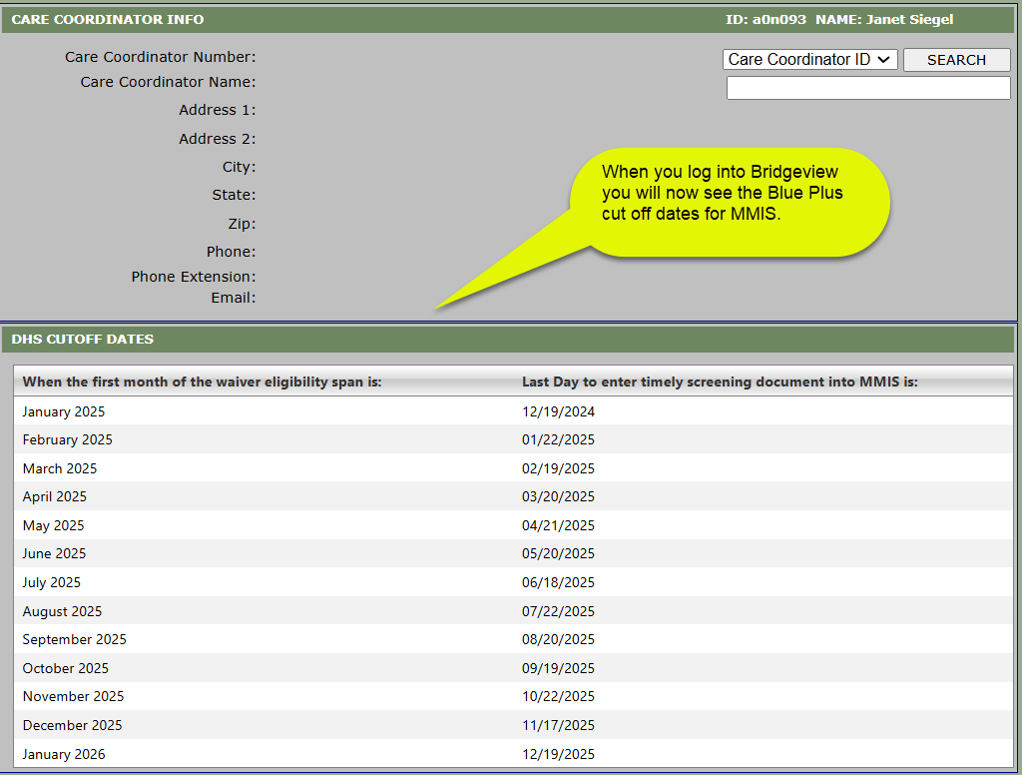
Bridgeview changes Coming soon!!

Slide 9
CFSS Overview Reminders
Member must choose a CFSS Consultation provider and confirm that they are accepting new clients. This consultation provider will work with the member to develop and select CFSS providers for their care plan.
Refer to the Care Coordination Website for the instructions on creating service agreement for CFSS service agreement.
Follow the list of CFSS providers from the Care Coordination Website
Questions reach out to your Partner Relations Consultant

Slide 10
CFSS Important Links
Care Coordination Website
DHS Website
CFSS Guidance
Agency CFSS BV Service Agreement
Budget CFSS BV Service Agreement
CFSS Provider Lists
CFSS Policy Manual
CFSS Forms and Documents
CFSS Frequently Asked Questions (FAQ)
CFSS Consultation Services Provider List
DSD Training Handouts Archive
DHS Website:
Notes:
Here are links to essential documents and sights.
The Care Coordination website contains BCBS specific guidance and how to enter authorizations into Bridgeview and the DHS website provides direction on the CFSS process

Slide 11
CFSS FAQs
Consultation service agreements are approved for 6 sessions for the full waiver span. If the consultation provider requests additional visits, then modifying the existing service agreement and then you can add service description notes.
Transitional PCA services are entered as MA Plan services for the first 6-months of the waiver. If a 3-month authorization has already been entered, create a new authorization for the next 3-month span. Do not modify the existing auth.
For all CFSS providers (Consultation, FMS and PCA) licensed providers are listed on the CFSS provider list located on the Care Coordination website. This list is updated on a weekly basis.
Any questions, email Bridgeview.Service.Agreements@bluecrossmn.com

Slide 12
Questions
For process related questions, contact your Partner Relations Consultant or email: Partner.Relations@bluecrossmn.com
For technical questions related to entering service agreements, contact the Bridgeview Team: Bridgeview.service.agreements@bluecrossmn.com
Notes:
We encourage you to start with the CFSS DHS site when you have questions and if you still cannot find what you are looking for reach out to Partner Relations Consultant.

Slide 13
Thank ou!!!

