Slide 1
Serving Hispanic and latino older adults
Culturally Appropriate Engagement for Authentic Connection
Ana Isabel and Carla Kohler
November 19, 2024
Notes:
KIM INTRODUCE CARLA & ANA ISABEL
CARLA----

Slide 2
Agenda
Welcome
Constelacion Latina and Purpose
Introduction to MN Compass – Hispanic & Latino Demographic Data
Cultural Engagement Approach – Recommendations when serving Older Adults
Q&A
Closing
Notes:
CARLA –

Slide 3

Notes:
ANA ISABEL

Slide 4
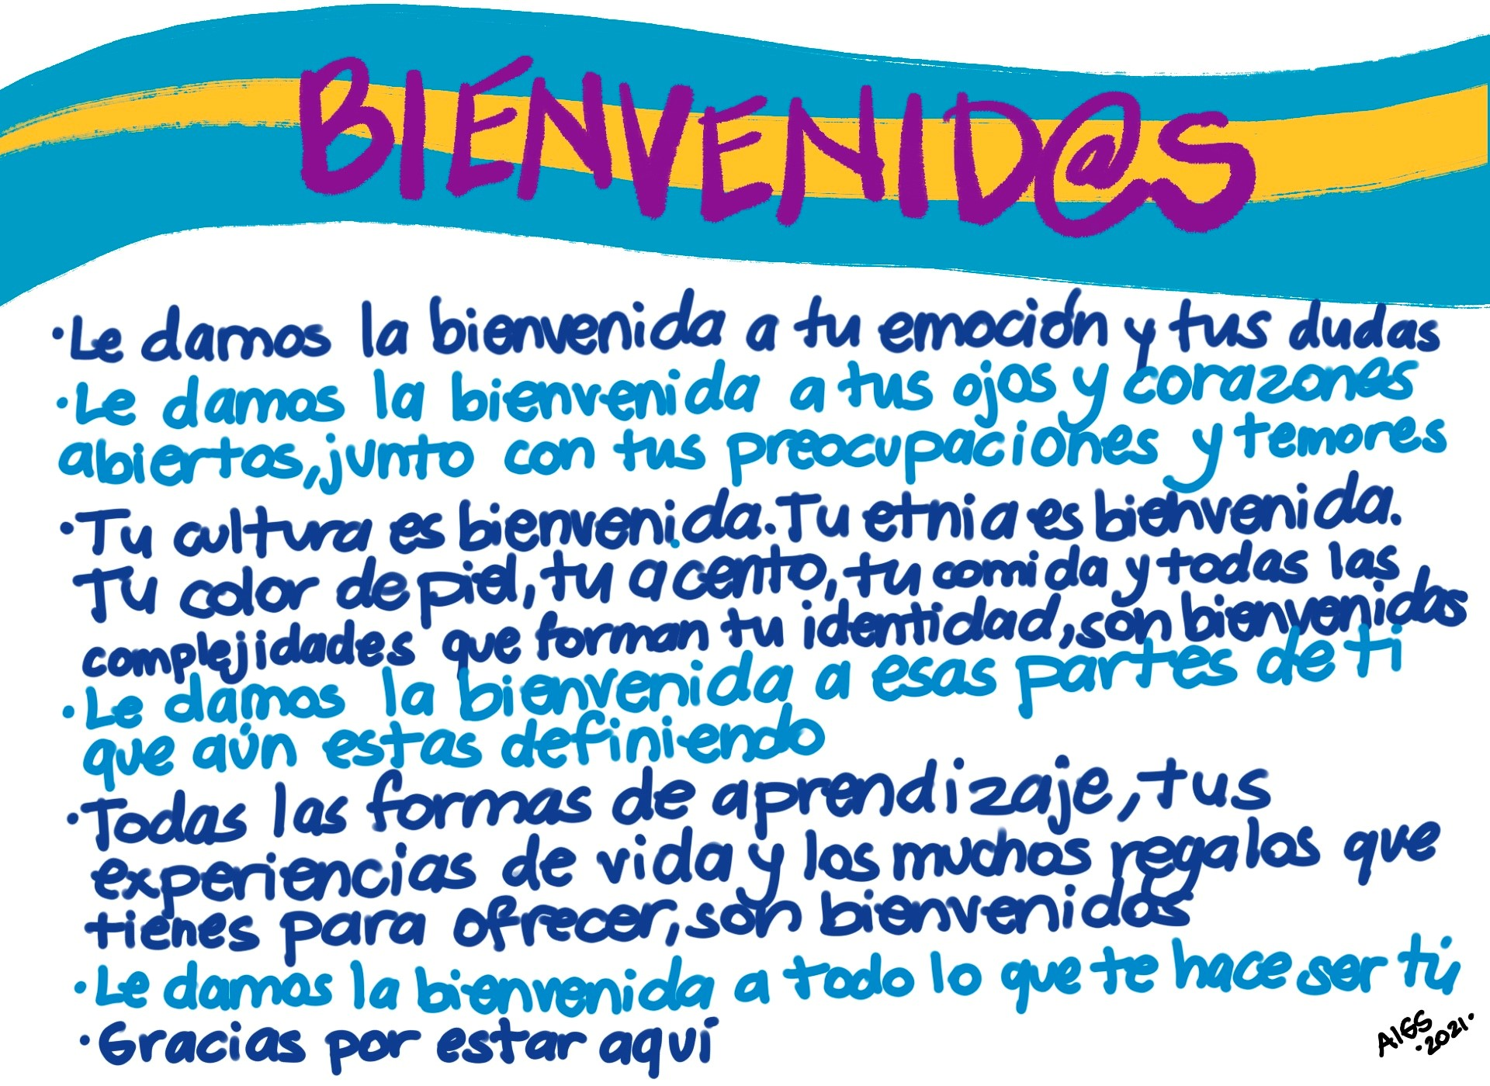
Notes:
ANA ISABEL --

Slide 5
Purpose
To improve services that result in increased quality of health outcomes by delivering culturally informed and responsive services to Latino/Hispanic 65+ members.
We will be:
Learning the demographic landscape
Addressing RHE and important cultural values
Recommendations for authentic member engagement
Notes:
ANA ISABEL ---
ANA ISABEL HANDS OFF TO ALLISON -----

Slide 6
Minnesota’s Hispanic and Latino populations
Trends from Minnesota Compass
November 19, 2024
Allison Liuzzi
Minnesota Compass | Wilder Research
Notes:
Introduce Allison, bio, and MN Compass and pass to her.

Slide 7

More than
370,000
Hispanic
and Latino
Minnesotans
Notes:
SOURCE: https://www.mncompass.org/chart/k199/population-race#1-5523-g
Since 2000, our third largest racial / ethnic group (after White and Black residents)

Slide 8
Minnesota’s Hispanic and Latino population is nearly six times larger than in 1990
588% growth
Notes:
SOURCE: https://www.mncompass.org/chart/k199/population-race#1-5523-g

Slide 9
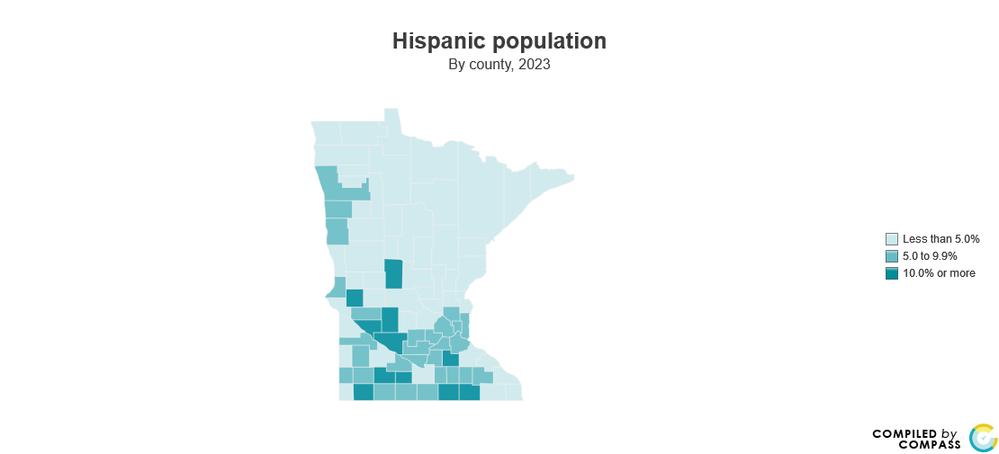
11 of 87 counties where at least one in ten residents is Hispanic or Latino
Watonwan
31%
Nobles
35%
Notes:
SOURCE: https://www.mncompass.org/chart/k199/population-race#1-5059-g

Slide 10
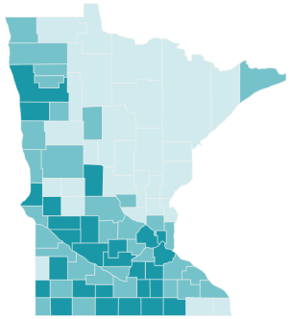
27 of 87 counties where at least one in ten youth residents is Hispanic or Latino
Watonwan
47%
Nobles
51%
Notes:
SOURCE: https://www.mncompass.org/chart/k268/population-trends#1-5479-g

Slide 11
All Minnesotans and Hispanic / Latino Minnesotans have very different age structures
ZERO GROWTH
RAPID GROWTH
Notes:
SOURCE: U.S. Census Bureau, 2023 Population Estimates.

Slide 12
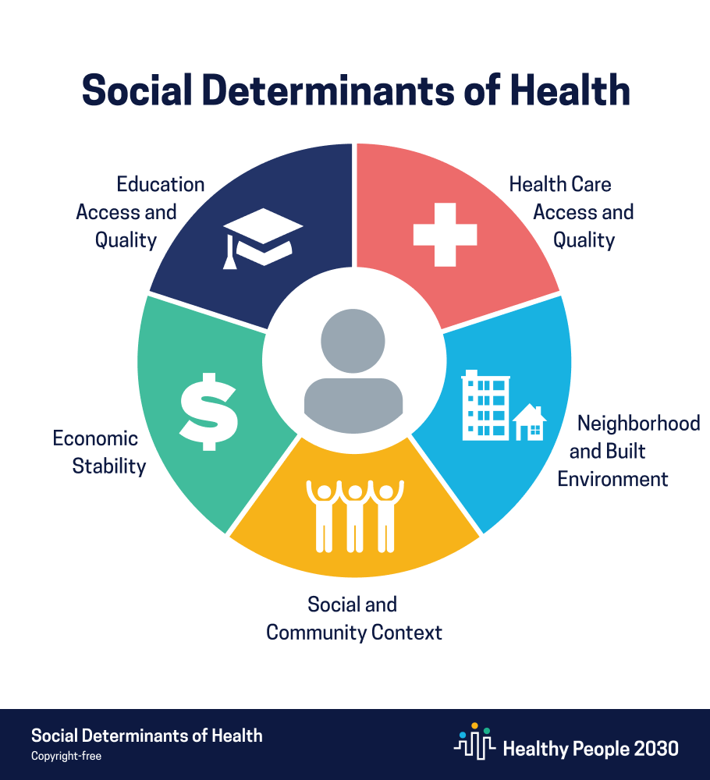
Social determinants of health
“are the conditions in the environments where people are born, live, learn, work, play, worship, and age that affect a wide range of health, functioning, and quality-of-life outcomes and risks.”
Notes:
SOURCE: Healthy People 2030, U.S. Department of Health and Human Services, Office of Disease Prevention and Health Promotion. Retrieved November 11, 2024, from https://odphp.health.gov/healthypeople/objectives-and-data/social-determinants-health

Slide 13
~ U.S. Centers for Disease Control and Prevention
“Social determinants of health have been shown
to have a greater influence on health than either
genetic factors or access to healthcare services.”
Notes:
SOURCE: https://www.cdc.gov/about/priorities/why-is-addressing-sdoh-important.html

Slide 14
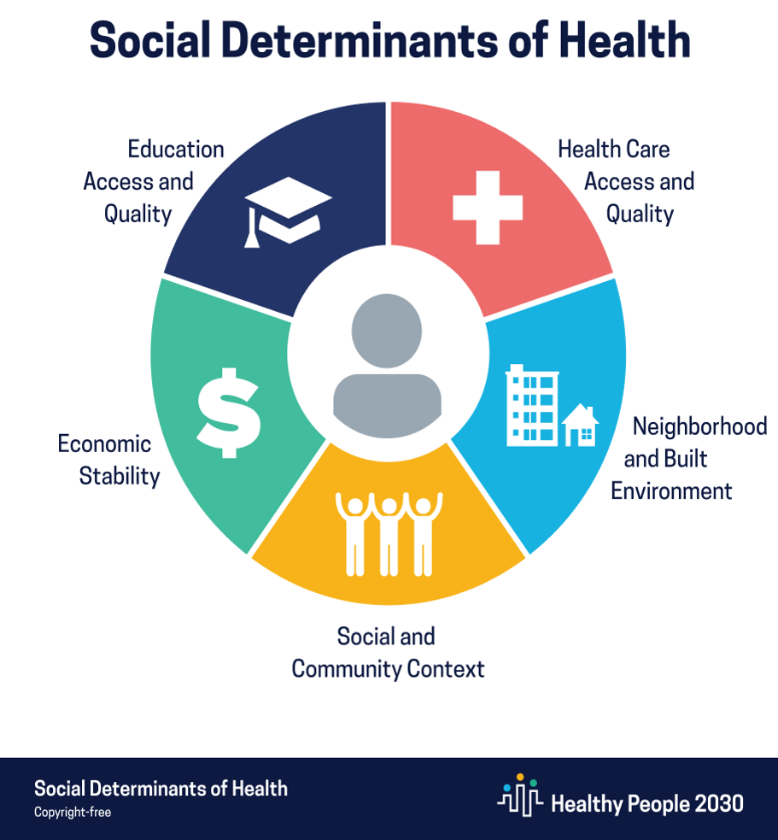
Social determinants of health
“are the conditions in the environments where people are born, live, learn, work, play, worship, and age that affect a wide range of health, functioning, and quality-of-life outcomes and risks.”
Notes:
SOURCE: Healthy People 2030, U.S. Department of Health and Human Services, Office of Disease Prevention and Health Promotion. Retrieved November 11, 2024, from https://odphp.health.gov/healthypeople/objectives-and-data/social-determinants-health

Slide 15

Education access and quality of Hispanic and Latino Minnesotans
K-12 proficiency
Among the lowest levels of proficiency in reading, science, and math across races and ethnicities
High school graduation
One of the lowest rates of on-time high school graduation, both within Minnesota and across the nation
69% and ranked last among states
Notes:
SOURCES:
3rd grade reading (26%, lowest): https://www.mncompass.org/chart/k195/3rd-grade-reading-scores#1-6486-g
5th grade science (22%): https://www.mncompass.org/chart/k398/students-meeting-exceeding-5th-grade-science-standards#1-10127-g
8th grade math (19%): https://www.mncompass.org/chart/k339/8th-grade-math-scores#1-7874-g
High school graduation: https://www.mncompass.org/chart/k177/high-school-graduation#1-6084-g
National ranking: https://www.mncompass.org/chart/k177/high-school-graduation#1-12658-g

Slide 16
Education access and quality of Hispanic and Latino Minnesotans
Adult educational attainment
Lagging behind in 2- and 4-year degree receipt
Smaller share of adults with a bachelor’s degree or higher
26% and 40%, respectively
Notes:
SOURCES:
2-year degrees: https://www.mncompass.org/chart/k330/postsecondary-degree-completion#1-9215-g
4-year degrees: https://www.mncompass.org/chart/k330/postsecondary-degree-completion#1-9214-g
Bachelor’s degree or higher: https://www.mncompass.org/chart/k204/educational-attainment#1-10628-g

Slide 17
Social determinants of health
“are the conditions in the environments where people are born, live, learn, work, play, worship, and age that affect a wide range of health, functioning, and quality-of-life outcomes and risks.”
Notes:
SOURCE: Healthy People 2030, U.S. Department of Health and Human Services, Office of Disease Prevention and Health Promotion. Retrieved November 11, 2024, from https://odphp.health.gov/healthypeople/objectives-and-data/social-determinants-health

Slide 18
Economic stability of Hispanic and Latino Minnesotans
$
Poverty rate
Higher than the statewide rate
14% and 9%, respectively
Household income
More than $10,000 below the statewide average
$72,500 and $85,100, respectively
$
Notes:
SOURCES:
Median household income: https://www.mncompass.org/chart/k202/median-income#1-4960-g
Poverty: https://www.mncompass.org/chart/k203/poverty#1-6768-g

Slide 19
Economic stability of Hispanic and Latino Minnesotans
$
Employment
Just below the statewide rate
76% and 79%, respectively
Homeownership
Lower homeownership rate than statewide average
56% and 72%, respectively
$
Notes:
SOURCES:
Proportion of adults working: https://www.mncompass.org/chart/k174/proportion-adults-working#1-6026-g
Homeownership rate: https://www.mncompass.org/chart/k189/homeownership-gap#1-5598-g

Slide 20
Economic stability of Hispanic and Latino Minnesotans
$
Food security
Double the share of households that sometimes / often do not have enough to eat, compared to statewide average
$14% and 6%, respectively
Food security among children
Triple the share of households with children that sometimes / often do not have enough to eat
$14% and 6%, respectively
$
Notes:
SOURCE:
Phase 4.2 Cycle 09 Household Pulse Survey: August 20 – September 16, Minnesota, https://www.census.gov/data/tables/2024/demo/hhp/cycle09.html

Slide 21
Social determinants of health
“are the conditions in the environments where people are born, live, learn, work, play, worship, and age that affect a wide range of health, functioning, and quality-of-life outcomes and risks.”
Notes:
SOURCE: Healthy People 2030, U.S. Department of Health and Human Services, Office of Disease Prevention and Health Promotion. Retrieved November 11, 2024, from https://odphp.health.gov/healthypeople/objectives-and-data/social-determinants-health

Slide 22

Social and community context of Hispanic and Latino Minnesotans
Student connection to caring adults
Share of students connected to a caring adult just shy of statewide estimate
49% and 54%, respectively
Student resilience
4th graders who keep working hard even when they feel like quitting similar to statewide estimate
71% and 69%, respectively
Notes:
SOURCES:
Connection to adults: https://www.mncompass.org/chart/k269/connection-caring-adults#1-3739-g
Resilience: https://www.mncompass.org/chart/k691/students-who-work-hard-when-when-they-feel-quitting#0-15123-g

Slide 23
Social and community context of Hispanic and Latino Minnesotans
Voter turnout
Lower voter turnout during 2022 midterm election, compared to statewide turnout overall
41% and 61%, respectively
Lower voter turnout during 2020 presidential election
63% and 80%, respectively
Notes:
SOURCE: https://www.mncompass.org/chart/k180/voter-turnout-0#1-13608-g

Slide 24
Social determinants of health
“are the conditions in the environments where people are born, live, learn, work, play, worship, and age that affect a wide range of health, functioning, and quality-of-life outcomes and risks.”
Notes:
SOURCE: Healthy People 2030, U.S. Department of Health and Human Services, Office of Disease Prevention and Health Promotion. Retrieved November 11, 2024, from https://odphp.health.gov/healthypeople/objectives-and-data/social-determinants-health

Slide 25

Neighborhood and built environment of Hispanic and Latino Minnesotans
Children’s enrichment activities
Lower participation in out-of-school activities, compared to statewide estimate
46% and 64%, respectively
Notes:
SOURCE: https://www.mncompass.org/chart/k270/enrichment-activities#1-3697-g

Slide 26
Neighborhood and built environment of Hispanic and Latino Minnesotans
Housing cost burden
One in three pay too much for housing, higher than statewide housing cost burden
35% and 25%, respectively
Crime victimization
Higher-than-average rate of crime victimization, compared to the statewide rate
449 victims per 100,000 residents, versus 289
Notes:
SOURCES:
Housing cost burden: https://www.mncompass.org/chart/k188/cost-burdened-households#1-12711-g
Crime: https://www.mncompass.org/chart/k170/crime-rate-0#1-15575-g

Slide 27
Social determinants of health
“are the conditions in the environments where people are born, live, learn, work, play, worship, and age that affect a wide range of health, functioning, and quality-of-life outcomes and risks.”
Notes:
SOURCE: Healthy People 2030, U.S. Department of Health and Human Services, Office of Disease Prevention and Health Promotion. Retrieved November 11, 2024, from https://odphp.health.gov/healthypeople/objectives-and-data/social-determinants-health

Slide 28

Health care access and quality among Hispanic / Latino Minnesotans
Health care coverage
Much lower levels, compared to statewide
84% and 95%, respectively
Low birth weight
Rates of low birth weight the same as statewide rates
6% and 6%, respectively
Notes:
SOURCES:
Health care coverage: https://www.mncompass.org/chart/k176/health-care-coverage#1-11239-g
Low birth weight: https://www.mncompass.org/chart/k169/low-birth-weight-0#1-5877-g

Slide 29
Health care access and quality among Hispanic / Latino Minnesotans
Disability
Lower prevalence of disability than statewide levels
9% and 12%, respectively
Chronic disease
Prevalence of obesity and diabetes on par with statewide rates
Obesity: 36% and 34%, respectively
Diabetes: 11% and 10%
Notes:
SOURCES:
Obesity: https://www.mncompass.org/chart/k175/obesity#1-10631-g
Diabetes: https://www.mncompass.org/chart/k190/diabetes#1-12838-g
Disability: https://www.mncompass.org/chart/k210/population-disability#1-12717-g

Slide 30
All Minnesotans and Hispanic / Latino Minnesotans have very different age structures
ZERO GROWTH
RAPID GROWTH
Notes:
SOURCE: U.S. Census Bureau, 2023 Population Estimates.

Slide 31

Older adults (65+) as a share of the population
All
Minnesotans
18%
1 million Minnesotans
Hispanic / Latino Minnesotans
5%
17,100 Minnesotans
Notes:
SOURCE: U.S. Census Bureau, 2023 Population Estimates.

Slide 32
Social determinants of health
“are the conditions in the environments where people are born, live, learn, work, play, worship, and age that affect a wide range of health, functioning, and quality-of-life outcomes and risks.”
Notes:
SOURCE: Healthy People 2030, U.S. Department of Health and Human Services, Office of Disease Prevention and Health Promotion. Retrieved November 11, 2024, from https://odphp.health.gov/healthypeople/objectives-and-data/social-determinants-health

Slide 33
Social determinants of health and older adults
Educational access and quality
Digital health literacy
$
Economic stability
Nutrition and food security
Social and community context
Social cohesion

Slide 34
Social determinants of health and older adults
Neighborhood and build environment
Aging in place
Health care access and quality
Transportation

Slide 35

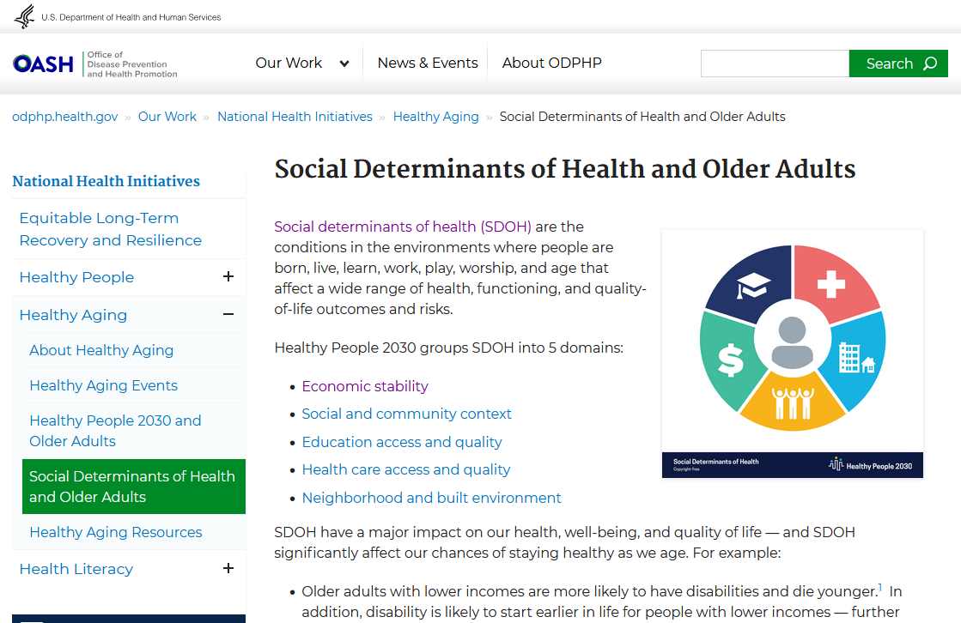
Social Determinants
of Health and
Older Adults
from the Office of Disease Prevention and Health Promotion
Notes:
SOURCE: https://odphp.health.gov/our-work/national-health-initiatives/healthy-aging/social-determinants-health-and-older-adults

Slide 36
Minnesota’s Hispanic and Latino cultural communities
Colombian
8,900
Salvadoran
15,700
Cuban
10,600
Ecuadorian
17,000
Mexican
214,300
Guatemalan
14,400
Puerto Rican
19,900

Slide 37
Minnesota’s Hispanic and Latino cultural communities
Colombian
8,900
Salvadoran
15,700
Cuban
10,600
Ecuadorian
17,000
Mexican
214,300
Guatemalan
14,400
Puerto Rican
19,900

Slide 38



What do we know about Colombian Minnesotans?
Much larger share are female (55%)
Vast majority are working-age
(70% age 18-64)
Small average household size, with one-third of households only including one single individual
Notes:
Also:
42% foreign-born

Slide 39
What do we know about Colombian Minnesotans?
Bottom | Middle | Top
 | Poverty rate (12%) | Median household income ($71,200)
 | Health insurance coverage (89%) | Homeownership rate (67%)
 |  | Housing cost-burdened (29%)
 |  | At least a high school degree (93%)
 |  | Proportion of adults working (79%)
Notes:
Comparatively speaking, fare pretty well

Slide 40
Minnesota’s Hispanic and Latino cultural communities
Colombian
8,900
Salvadoran
15,700
Cuban
10,600
Ecuadorian
17,000
Mexican
214,300
Guatemalan
14,400
Puerto Rican
19,900

Slide 41



What do we know about Cuban Minnesotans?
Only a quarter are foreign born (24%)
One in five have a disability
(20%)
Slightly larger share of
older adults
than other cultural communities (7%)
Notes:
Also:

Slide 42
What do we know about Cuban Minnesotans?
Bottom | Middle | Top
Proportion of adults working (72%) | Poverty rate (13%) | Median household income ($74,300)
 | Homeownership rate (52%) | Health insurance coverage (94%)
 | At least a high school degree (85%) | Housing cost-burdened (25%)
Notes:
Comparatively speaking, fare pretty well

Slide 43
Minnesota’s Hispanic and Latino cultural communities
Colombian
8,900
Salvadoran
15,700
Cuban
10,600
Ecuadorian
17,000
Mexican
214,300
Guatemalan
14,400
Puerto Rican
19,900

Slide 44



What do we know about Guatemalan Minnesotans?
Younger than other cultural communities, with almost half under age 18 (45%)
Half are foreign-born and one-third speak English “less than very well” (37%)
Only half live in the Twin Cities
(52%)
Notes:
Also:

Slide 45
What do we know about Guatemalan Minnesotans?
Bottom | Middle | Top
Median household income ($55,500) | Housing cost-burdened (39%)
Poverty rate (17%)
Health insurance coverage (72%)
Homeownership rate (45%)
At least a high school degree (58%)
Proportion of adults working (72%)
Notes:
Comparatively speaking, more barriers / challenges

Slide 46
Minnesota’s Hispanic and Latino cultural communities
Colombian
8,900
Salvadoran
15,700
Cuban
10,600
Ecuadorian
17,000
Mexican
214,300
Guatemalan
14,400
Puerto Rican
19,900

Slide 47

What do we know about Salvadoran Minnesotans?
Larger-than-average household size (3.8)
Almost half of households are married couples with kids
(45%)
Most speak a language other than English
at home
(81%)
Notes:
Also:

Slide 48
What do we know about Salvadoran Minnesotans?
Bottom | Middle | Top
At least a high school degree (60%) | Health insurance coverage (82%) | Median household income ($80,300)
 | Homeownership rate (50%) | Poverty rate (7%)
 | Housing cost-burdened (40%) | Proportion of adults working (80%)
Notes:
Comparatively speaking, some barriers / challenges

Slide 49
Minnesota’s Hispanic and Latino cultural communities
Colombian
8,900
Salvadoran
15,700
Cuban
10,600
Ecuadorian
17,000
Mexican
214,300
Guatemalan
14,400
Puerto Rican
19,900

Slide 50
What do we know about Ecuadorian Minnesotans?
Younger than other cultural communities, with 41% under age 18
Half are foreign-born (51%) and almost half speak English “less than very well” (46%)
Vast majority live in the Twin Cities
(92%)
Notes:
Also:

Slide 51
What do we know about Ecuadorian Minnesotans?
Bottom | Middle | Top
Median household income ($59,500) | Poverty rate (12%) | Homeownership rate (60%)
Health insurance coverage (76%) |  | Proportion of adults working (79%)
Housing cost-burdened (44%)
At least a high school degree (61%)
Notes:
Comparatively speaking, more barriers / challenges

Slide 52
Minnesota’s Hispanic and Latino cultural communities
Colombian
8,900
Salvadoran
15,700
Cuban
10,600
Ecuadorian
17,000
Mexican
214,300
Guatemalan
14,400
Puerto Rican
19,900

Slide 53
What do we know about Puerto Rican Minnesotans?
Vast majority are native born
(98%)
Slightly larger share of
older adults
than many other cultural communities (5%)
Small average household size, with one-third of households only including one single individual (29%)
Notes:
Also:
42% foreign-born

Slide 54
What do we know about Puerto Rican Minnesotans?
Bottom | Middle | Top
Poverty rate (17%) | Median household income ($63,600) | Health insurance coverage (93%)
Homeownership rate (35%) | Proportion of adults working (77%) | At least a high school degree (93%)
Housing cost-burdened (41%)
Notes:
Comparatively speaking, a mix of outcomes

Slide 55
Minnesota’s Hispanic and Latino cultural communities
Colombian
8,900
Salvadoran
15,700
Cuban
10,600
Ecuadorian
17,000
Mexican
214,300
Guatemalan
14,400
Puerto Rican
19,900

Slide 56


What do we know about Mexican Minnesotans?
By far, our largest Hispanic or Latino cultural community
(214,000)
Only a quarter are foreign born (27%)
Tend to fall
in the middle
on a range of quality-of-life outcomes
Notes:
Also:

Slide 57
What do we know about Mexican Minnesotans?
Bottom | Middle | Top
 | Median household income ($63,200)
 | Poverty rate (16%)
 | Health insurance coverage (84%)
 | Homeownership rate (52%)
 | Housing cost-burdened (34%)
 | At least a high school degree (70%)
 | Proportion of adults working (77%)
Notes:
Comparatively speaking, right in the middle of things

Slide 58
 | Colombian | Cuban | Ecuadorian | Guatemalan | Mexican | Puerto Rican | Salvadoran
Poverty | ● | ● | ● | ● | ● | ● | ●
Household income | ● | ● | ● | ● | ● | ● | ●
Adults working | ● | ● | ● | ● | ● | ● | ●
Health insurance | ● | ● | ● | ● | ● | ● | ●
Homeownership | ● | ● | ● | ● | ● | ● | ●
Housing cost burden | ● | ● | ● | ● | ● | ● | ●
High school degree+ | ● | ● | ● | ● | ● | ● | ●
Notes:
Comparatively speaking, fare pretty well

Slide 59
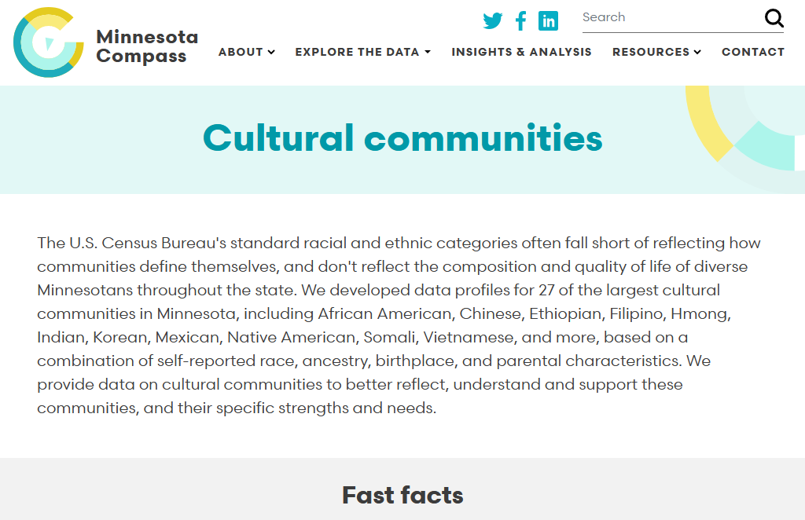
Data profiles
for Minnesota’s largest cultural communities
Notes:
SOURCE: https://www.mncompass.org/cultural-communities

Slide 60
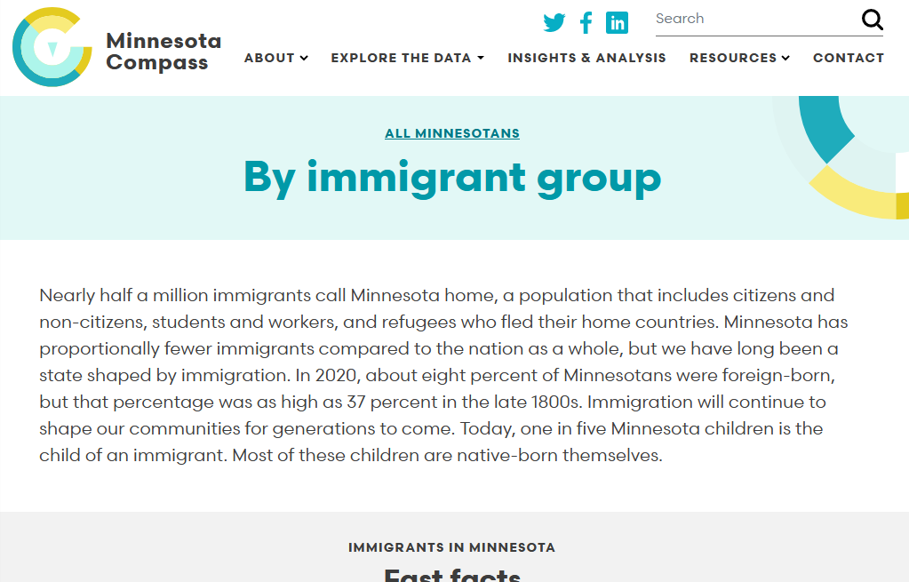
Charts and
data profiles
for Minnesota’s largest immigrant communities
Notes:
SOURCE: https://www.mncompass.org/topics/demographics/immigration

Slide 61
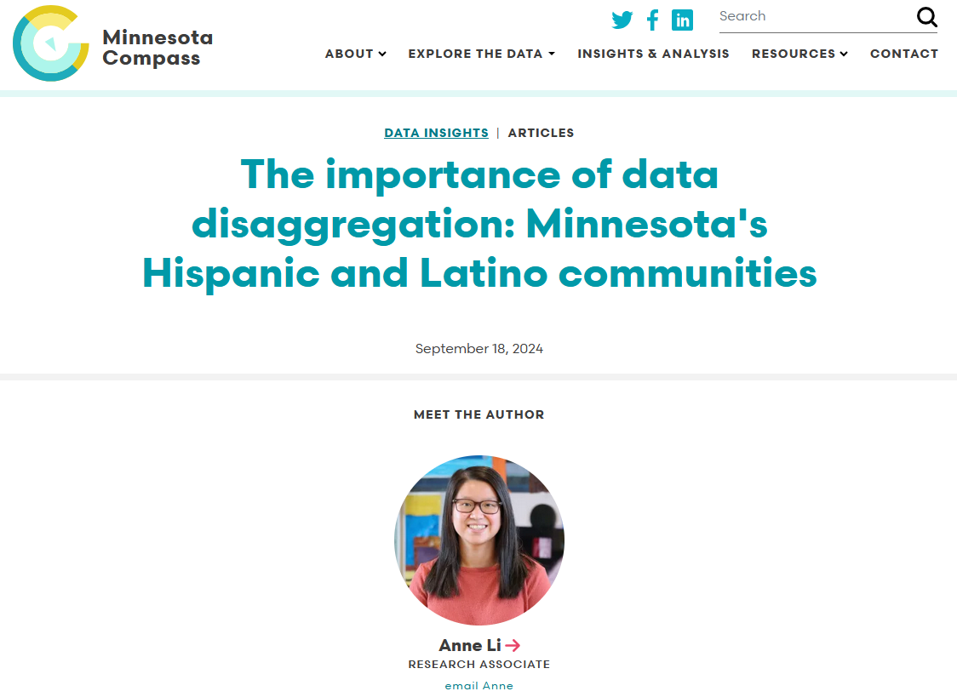
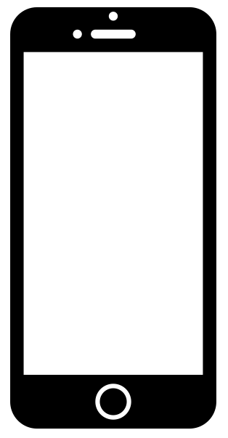
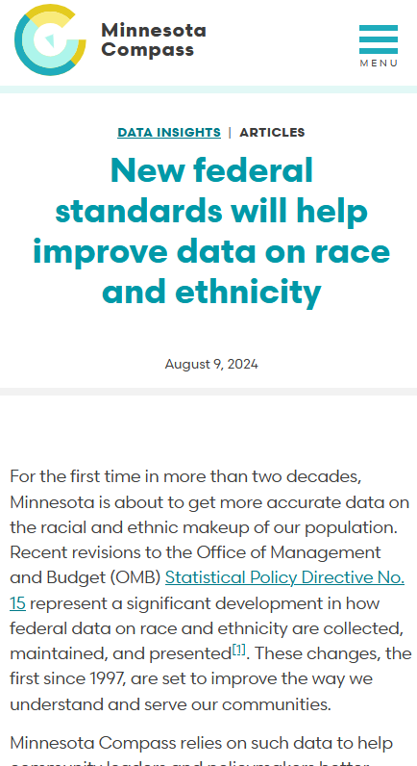
Notes:
SOURCES:
https://www.mncompass.org/data-insights/articles/importance-data-disaggregation-minnesotas-hispanic-and-latino-communities
https://www.mncompass.org/data-insights/articles/new-federal-standards-will-help-improve-data-race-and-ethnicity

Slide 62
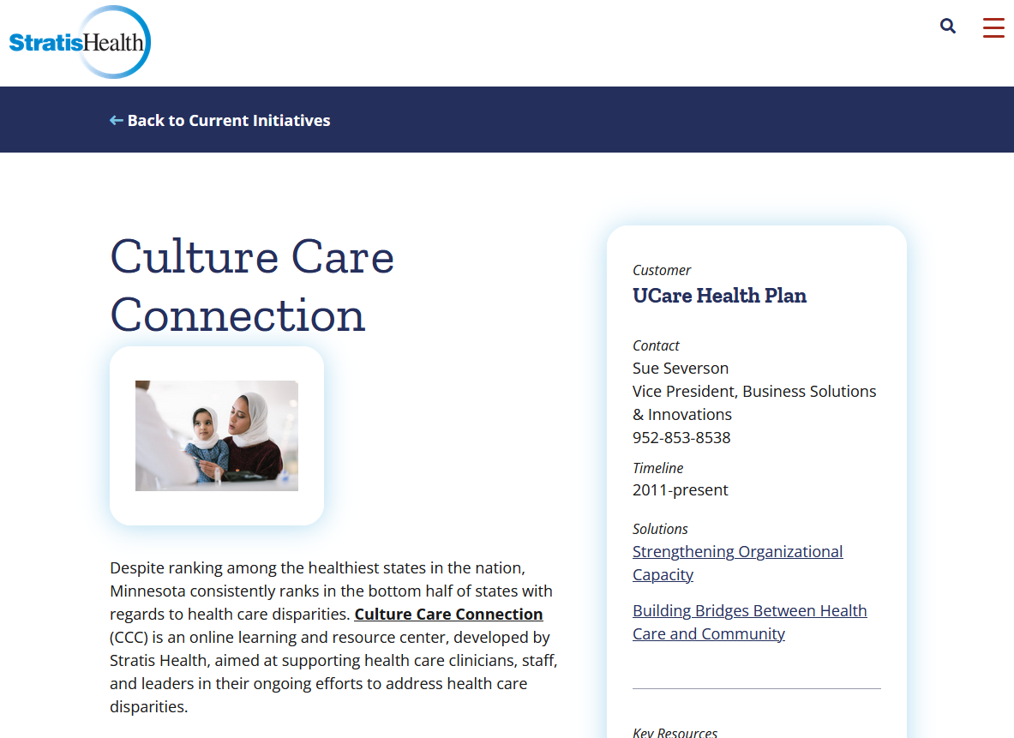
Culture Care Connection
from Stratis Health
Notes:
SOURCE: https://stratishealth.org/initiative/culture-care-connection/

Slide 63


Questions?
allison.liuzzi@wilder.org
Sign up for our monthly e-newsletter at www.mncompass.org
Find us on LinkedIn
Minnesota Compass | Allison Liuzzi
Connect with MN Compass on Facebook
Notes:
ALLISON TO CARLA

Slide 64
Recommendations for older adult engagement and authentic connection
Carla Kohler and Ana Isabel Gabilondo-Scholz
Notes:
ANA ISABEL –

Slide 65
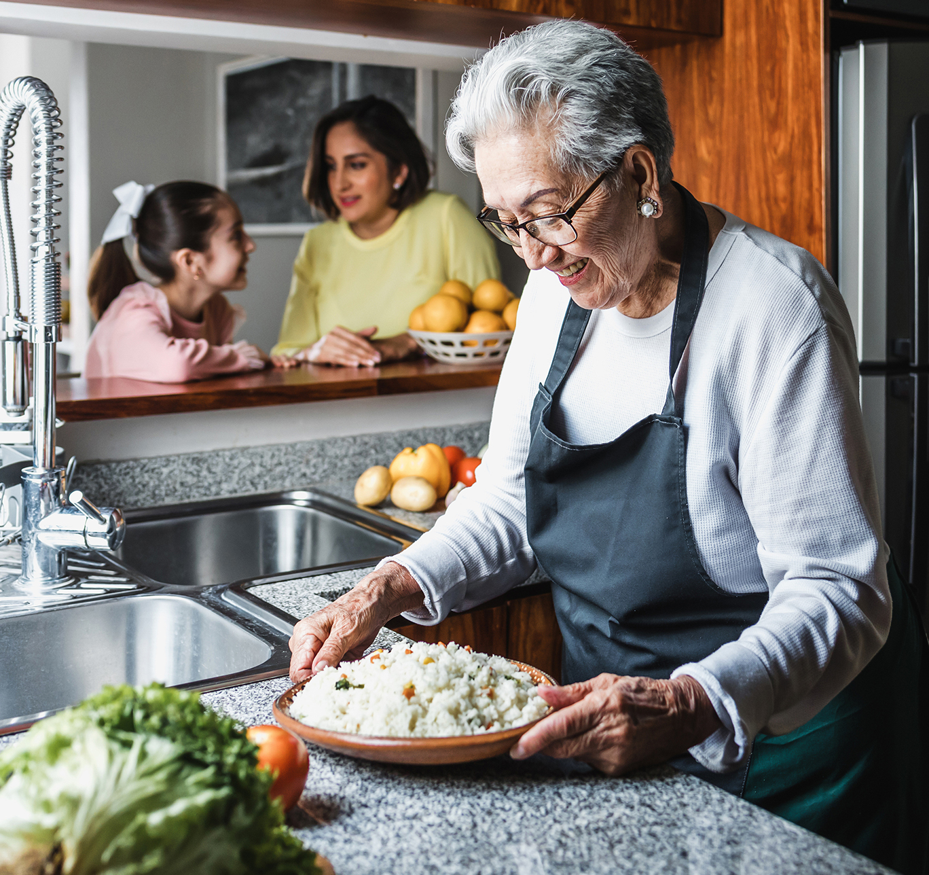
Racial and health equity approach
Cultural knowledge: There are more than 20 different Spanish-speaking countries in the world. All of them are represented in the US. (Minnesota has a large Mexican and Ecuadorian population)
Trust Building: Establishing Confianza or TRUST leads to effective communication and built rapport not only with the member but also with their family.
Follow-through. If you say you are going to do something, follow up with it, they will remember.
Notes:
ANA ISABEL ---
Different countries represented in MN, wanted to share there are more than 20 LA countries in the US. We are not a homogenous group. Recommendation in our RHE approach in our experience working with community. Not one size fits all. Best practices.
Embedding RHE in our work we are workign differently with communities and we are curating the way we engaging with them that is not a cookie cutter approach. By doing that you are authentically engaging in addressing racial and health inequities
Acknowledge our recommendations may be part of what they are already doing or
Systemic change (change in how we engage with members) in the role of care coordinator in providing resourece to our members and inbeding themselves in community. To be more successful in the latino community to quality of care that is essential as they age.
How communities get their information – word of mouth
We understand your time is limited under the RHE approach would facilitate your work if you understand who are the local communtiy leaders, what are the differences in the communitiy organizaitons and resources available, faith based orgs, churches when it's hard to reach commiunities. Sometimes having the blessing/ legitimacy by trusted leadership goes along way with engaging with Latino elders and commutniy.
Trusted community resources – not all resources are created equal, get to know and learn the resources you are offering, are they good? Are there others that are better or culturally competent? You will learn this from talking with members or community leaders and their experiences.
Community leaders know who's trusted in the community, who shows up.

Slide 66
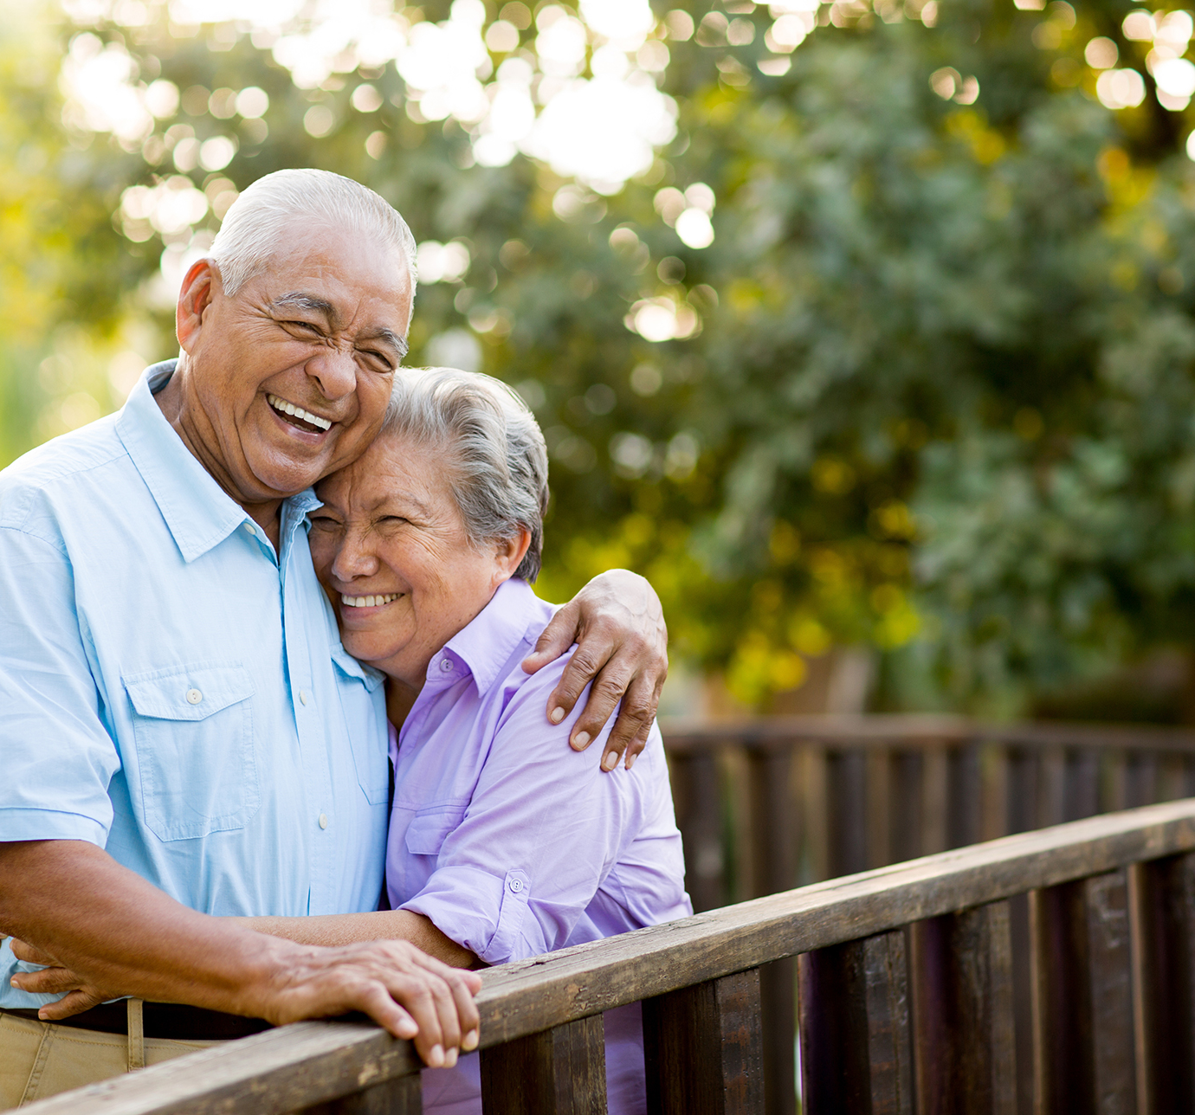
Racial and health equity approach
Beyond translated materials. Engaging with members must look beyond translated materials into other languages.
  Who are the trusted resources in the local community?
  What are trusted sites in the local community? (e.g., CBOS, faith-based organizations, schools).
Word of mouth. Be in community, attend local and cultural events.
Engage with members in their culture and language. Making sure Care Coordinators who are bicultural and bilingual that can facilitate in reaching the member.
Notes:
ANA ISABEL ---
Appropriate way to engage with members - Bilingual and bicultural care coordinators - We understand this may not always be the case; however, it should be our continuous guiding principal as we reach for our Blue Cross North Star Goal of advancing RHE. If not, how can we partner with a person or community leader to establish trust in the community.
Care coordinators supporting each other in supporting members. Facilitate engagement with the member, most of the time it will not be available, can you connect with others who are bicultural and bilingual to support bridging the relationship and build the trust

Slide 67
Cultural values: familismo
Familismo or familism is the cultural value/concept of putting family above self.
High preference for family caregiving: elder stays living within the household
Strong sense of purpose to care for older adult, respect for older adult as the head of the household, multigenerational households
Desire for older Latino to age at home with a known personal caregiver
Older adults seek support and family advice for making important decisions
RECOMMENDATIONS:
Support and provide resources around their family-centered decision making
Patriarchal structure – however, rely on family input. Decisions may take more time
Get to know other family members
Notes:
CARLA –

Slide 68
Cultural values: personalismo
Personalismo or personalism is the cultural value/concept of relationships built on mutual trust and respect.
Interpersonal relationships and informal conversation -not straight business- fosters authenticity and trust
Social interactions should be caring, compassionate, and warm – not rushed or hastily- to produce better outcomes.
Importance of religious and principles and values that many seniors hold dear as they navigate their healthcare interactions and healthcare decisions
RECOMMENDATIONS
Engage personally - share a cafecito or meal
Provide services and resources where they are at and in their home
Notes:
CARLA –--

Slide 69
Cultural values: Fatalismo
Fatalismo or will of god/fate is the cultural view/concept of Latinos view on a persons control over an illness has an external influence (good or bad) and is out of his or her hands.
Fatalistic view of life and death
It is what it is – left to a higher power
Believed that this cultural value results in delay/lack of action to seek health care/late diagnosis
RECOMMENDATIONS:
Mindset shift will take time
Cultural norms around preventive care need to be taught and supported
Notes:
CARLA ----

Slide 70
OTHER Social Engagement and connection recommendations
Addressing elder by last name or usted (e.g., Seῆora/Seῆor …)
Follow through
Patience and Grace
Technology vs Phone Call – varies
Be in Community – local and cultural events
Notes:
CARLA/ANA ISABEL ----

Slide 71
Q & A
What surprised you?
What has been your experience visiting/ working with a Hispanic family?
What resonates with you?
What questions do you have?
Notes:
ANA ISABEL

Slide 72
thank you & Resources
Carla Kohler, carla.kohler@bluecrossmn.com
Ana Isabel Gabilondo-Scholz, Anaisabel.GabilondoScholz@bluecrossmn.com
Resources
County of Ventura Area Agency of Aging: Aging & Disability Resource Center – VCAAA
National Library of Medicine: Better care for older Hispanics: identifying priorities and harmonizing care - PMC
Health and Health Care of Hispanic/Latino American Older Adults.pdf
A Program of The National Hospice and Palliative Care Organization: Caring Connections Latino Outreach

