Slide 1
Blue Plus-Consumer directed community supports (CDCS)
MSHO/MSC+ Partner Relations
December 5th, 2024

Slide 2
Learning OBJECTIVES
Increase care coordination awareness and understanding of the CDCS EW service.
Learn the Roles and Responsibilities of Member/Managing Party, Care Coordinator, Financial Management Services (FMS) and Support Planner
Learn about allowable and unallowable goods and services
Learn about Technical Assistance
Learn about Addendums
Approving and authorizing CDCS services in Bridgeview
Learn about upcoming CDCS changes
Disclaimer: This training is not meant to replace DHS’ CDCS training, the CDCS Lead Agency Operations Manual, or the Community Based Service Manual. Some information is directed towards fee-for-service only.

Slide 3
Cdcs Overview
Notes:
Kim

Slide 4
CDCS Overview
CDCS = Consumer Directed Community Supports
CDCS is available to people on home and community-based services (HCBS) waivers and the Alternative Care (AC) program. It gives members flexibility in service planning and responsibility for self-directing their services, including hiring and managing support workers. It may include traditional goods and services as well as self-designed services.
*Note: Self-directed services does not mean unregulated.
Notes:
Read slide

Slide 5
Cdcs General knowledge
Notes:
Kim

Slide 6
CDCS basics
CDCS is an EW service
Cannot be on CDCS if residing in Customized Living, Licensed Foster Care, or restricted MA.
CDCS budget is based on the member’s assessed needs and case mix classification.
Support Planner optional BUT strongly encouraged
FMS is required to be used (cannot be the same company as Support Planner)
Can utilize formal EW services/providers
Expenditures are for the direct benefit of the person
CDCS and CFSS budget model are very different programs
Notes:
Read slide
CDCS is not a waiver, it is a service within the Elderly Waiver.
If a Support Planner is not chosen, the member or responsible party will write the plan, and it is not the responsibility of the Care Coordinator.

Slide 7
Roles and Responsibilities
Member/Managing Party
The member and/or legal representative must designate a Managing Party. This person is responsible for the following:
Develop and implement the CDCS Plan with the member
Facilitate the hiring process
Manage employees
Approve timesheets
Submit bills for reimbursement
Maintain records/receipts
Review Expense reports
Notes:
Read first, then the slide. These responsibilities are at a minimum. The managing party may be the member themselves, or it may be a family member, friend, or some other trusted individual. Whomever it is, they have specific responsibilities to make the CDCS program successful for the member. Read slide

Slide 8
Roles and Responsibilities
Care Coordinator:
The Care Coordination must:
Educate member/responsible party on CDCS program
Review plan and obtain plan approval (CCs cannot complete CDCS plan
documents on behalf of members)
Monitor health and safety
Monitor utilization of budget by reviewing FMS spending summaries
Ensure CDCS guidelines are followed
Notes:
Read first, then slide: The Care Coordinator must first educate the member/responsible party on the CDCS program so that the member is able to make an educated decision on whether or not they want to move forward with the CDCS program.

Slide 9
Roles and Responsibilities
Care Coordinator-CONTINUED:
Be familiar with and comply with Care Coordination/Case Management CDCS requirements
By approving and monitoring CDCS plans the CC will:
Review CDCS CSP for appropriateness
Ensure the Screening Document is entered in MMIS
Follow current processes to authorize, deny, terminate, or reduce services as needed.
Sign and date approved CDCS Community Support Plans before the start of services
Collaborate with FMS Provider and Support Planner as applicable
Communicate CDCS legislative budget increases as applicable
Provide oversight and education to ensure members comply with state and federal law
Complete MnCHOICES assessments and Support Plans within the required timelines.
Notes:
Read slide

Slide 10
Roles and Responsibilities
Financial Management Service (FMS):
FMS is required with CDCS and assists with:
Financial tasks
Documenting and reporting all expenditures of funds
Dispersing expense summaries
Billing
Paying caregivers and vendors for authorized goods and services
Employer-related responsibilities
Education for members on how to employ workers
Filing Federal and state payroll taxes on behalf of the member
Obtaining Workers Compensation
Initiates background studies for workers
Notes:
Read slide: then indicate ** There is a monthly fee charged for the service of an FMS that must be paid for and fit within the CDCS budget.

Slide 11
Roles and Responsibilities
Support Planner:
This is an optional service with primary tasks of:
Facilitating the development of the CDCS CSP and Health and Safety Plan
Completing plan-related documents throughout the year
Finding and training staff
Finding resources as needed
Remaining current on the rules, policies, and procedures of the CDCS program
Notes:
Read slide. Then reminder that Support Planner fees also must be paid for and fit within the CDCS budget. The Support Planner is NOT the Care Coordinator. Please refer to the CDCS Resource Guide for additional information.

Slide 12
Cdcs process/High overview
Notes:
Kim

Slide 13
CDCS order of events
Notes:
Briefly review slide steps.

Slide 14
WHAT CAN BE APPROVED WITH cdcs?
Notes:
Sara

Slide 15
allowable
Provides supports, services, or goods that help the member live and participate in their community and is required to support the member’s health and safety
EAA (ramps/vehicle modifications) and can use a vendor not enrolled with DHS
Assistive Technology
Supplies and Equipment (could order directly from Amazon or Walmart)
Monitoring Technology
Transportation (Uber, Lyft, pay CDCS staff mileage)
Personal Support (Paid Spouse, CDCS Staff, Caregiver relief, Companionship)
ILS/ICLS
Day services
Making a bike adaptable
*Note: Not an all-inclusive list
Notes:
Expenditures are based upon the member’s assessed needs identified in the assessment. It should include a description of the item and its related needs. EW is the last resort payor, and CDCS is an EW service, so items that are covered through Medical Assistance and MSHO supplemental benefits should not be requested or approved. Massage Therapy could be approved for the member. However, it cannot be approved for a caregiver who has back problems due to transferring the member, because it is not the direct benefit for the member.

Slide 16
Unallowable LIMITS
Services and goods covered by MA, Medicare, or MSHO Supplemental Benefits
Supplements
BlueRide
Incontinence Products
Chiropractor who does not take insurance
Services and goods provided to or directly benefiting individuals other than members using CDCS
Services and goods that are recreational
Services and goods for comfort or convenience
Items or support normally provided by the member/family or spouse without a disability or condition
*Note: Not an all-inclusive list
Notes:
This is the guidance DHS has currently provided

Slide 17
UNALLOWABLE EXPENSE
All prescription and over-the-counter medications
Animals
Attorney cost
General vehicle maintenance
Room and Board
Utilities
Tickets
Insurance
Mileage for Paid Spouse
Using funds for a chiropractor who does not take insurance.
Internet once unbundling occurs.
*Note: Not an all-inclusive list
Notes:
No travel, lodging, or meal expenses. Membership to the zoo, sporting events, plays, and movies. Expenditure for comfort or convenience, such as typical beds, wills, or trusts. It should be cost-effective to meet assessed needs. It should NOT be purchased before approval and only for the agreed amount or less.

Slide 18
Rate of PAY AND HOURS
Max for Paid Spouse (need one ADL)
Per Hour
Min $19
Max $22.74 with PTO and $23.80 without PTO
Max hours a week is 60hrs, but overtime rules apply after 40.
CDCS staff
i.e., Child, niece/nephew, sibling, or friend
Per Hour
Min $19
Max
$27-30 (Rationale should be asked/provided) Over $30 consult with PR.
Anything above 40-hour overtime rules would apply
If formal service is provided (Adult Day), the provider MUST use the DHS-established rate and follow CBSM regarding eligibility.
Family can opt out of PTO, but FMS should determine this to ensure the criteria is met.
*Note: 1/1/2025 CDCS and Paid Spouse rate of pay minimum $20
Notes:
A person who uses CDCS or their representative determines the hourly rate for the direct service provider. Only guidance is offered if the rates are within a reasonable range of similar services in the person’s community and aligned with the skills and experience required to perform the job tasks that the person needs. Example: The judge did not find any law or policy that specifically states that the lead agency makes the rate of pay determination. Judge did not find a law or policy that states the law agency determines what sources can be used to determine that rate of pay. This is one judge decision but something to be mindful of.

Slide 19
CDCS addendums AND LEGISLATIVE INCREASES
Notes:
Sara

Slide 20
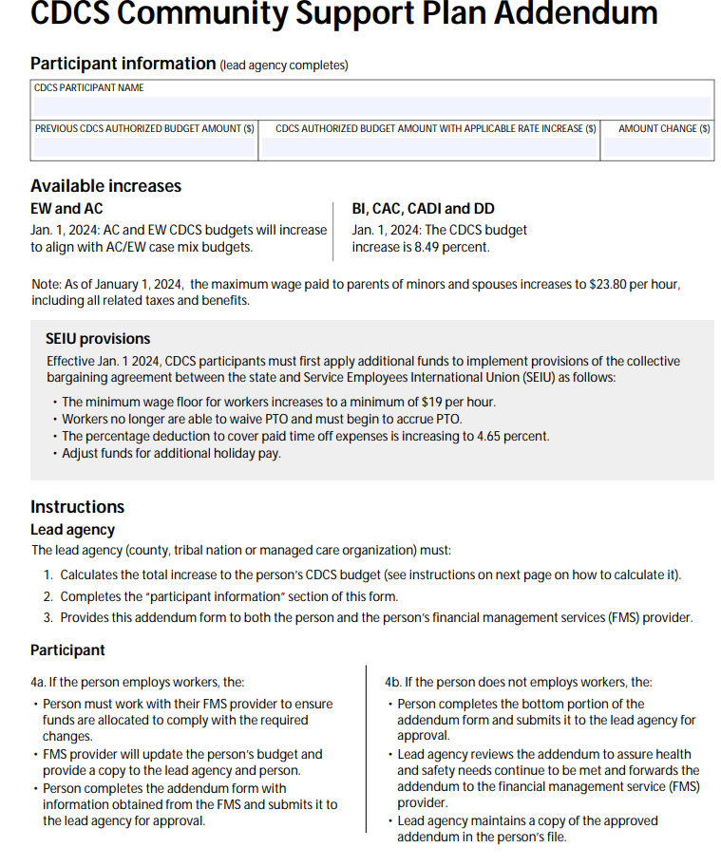
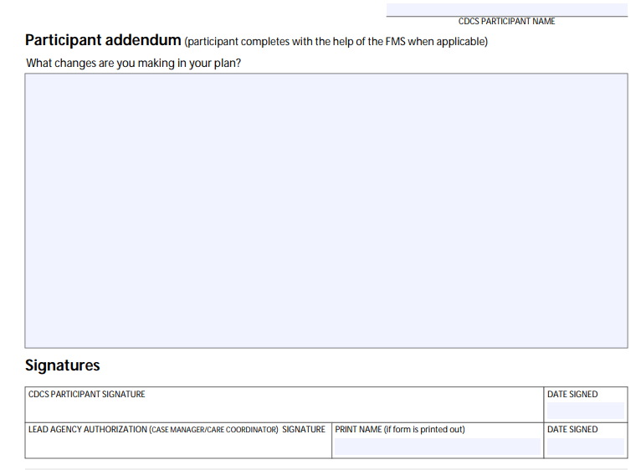
6633A
When there is a legislative rate increase, Care Coordinators must:​
Notify member/Resp Party via DHS 6633A (mail and/or email DHS 6633A with rate increase) ​
Upon receipt of the signed 6633A, review and determine within 30 days ​
Notify FMS and member with approved CDCS CSP addendum, as applicable​
Notes:
It’s been confirmed there will be a Legislative increase on 1/1/2025. Communication/communique will be provided, and you should send 6633A to the member and/or resp party before 1/1/2025. Ideally, you would include the Support Planner so they could assist. Some mandatory increases include a higher rate of pay.

Slide 21
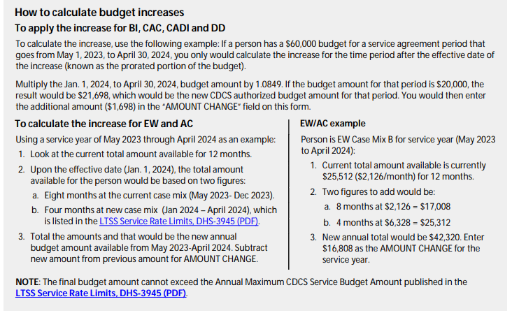
How to complete 6633A-EXAMPLE
Notes:
Member is case mix B. The previous budget was $25,512 before legislative changes that occurred on 1/1/2024. Current span May 2023 through April 2024. May 2023-December 8 months was $2,126 a month=$17.008. January to April is 4 months at $6,328=$25,312. Add together, and the new budget is $42,320. Amount change is the difference. We need to inform people of the maximum budget, but they must do an addendum to show us. They will need to do an addendum if they want to make changes. With that said, if required, i.e., $20, it must be done regardless.

Slide 22
Addendum/changes throughout span
An addendum is needed when a member wants to revise the plan during the service plan year.
Best practice is to obtain a written (preferred) or verbal agreement from the member for a revision to the original support plan and document this and communicate this to member, FMS, and Support Planner re: approval, denial, or pended decision.
Addendums cannot be accepted/approved within 30 days of the plan year’s end, unless for health and safety reasons.
Addendum Examples:
Correcting FMS fees, increasing wages/hours, adding or increasing/decreasing services/items.
The Lead Agency has 30 days to review the addendum/revision, which must be processed/approved ASAP.
Addendum decisions (Approved, pended, denied) should be communicated with the member, FMS, and Support Planner if applicable (and case noted). A copy of the addendum should be saved in the member file/records.
If something via addendum is denied, terminated, or reduced, follow the CDCS-DTR -Guide.
Notes:
Note: If somebody does an addendum because they want to add something such as a ramp, and this ramp would put them over the budget max amount, they will need to reduce something such as Homemaking.

Slide 23
Technical ASSISTANCE
Notes:
Sara

Slide 24
WHAT IS A Technical ASSISTANCE
Is a way for lead agencies to notify members/Responsible Party about CDCS concerns
CDCS is an EW service, but a member can be involuntarily exited from CDCS (not waiver) if it is not used appropriately.
Unless a member is at immediate risk/harm, technical assistance should be used to monitor and show that we are working with members.
Notes:
Read Slide

Slide 25
when should it be done
According to CBSM, reasons for Technical Assistance may include but are not limited to:
Purchasing items not approved in CDCS CSP,
Repeatedly returning items purchased
Unapproved overtime
Unapproved overlapping hours
Submitting timecards when hospitalized
Not turning in timesheets by the deadline
Pre-signing timecards
Submitting an unreasonable number of changes/addendums for the plan year
Not following CDCS CSP
Notice from FMS of either over or under-spending.
If needed, the Care Coordinator completes the Notice of Technical Assistance, ensures that all necessary information is included, and sends it to the member/resp party.
Keep a copy of Technical Assistance in file/records.
If the 4th Notice of Technical Assistance is in one plan year, the member will be discharged from CDCS.
*Note: CC must request a CDCS Technical Assistance Member Letter from your Partner Relations Consultant.
Notes:
Read Slide: We are considering posting the Technical Assistance CDCS letter to the website under the CDCS section. We will communicate to everyone if the decision is to add to the website.

Slide 26
Involuntary exit
There is a process that must be followed to discharge a member involuntarily from CDCS. A member may exit from CDCS and be offered waivered services or MA state plan home care services upon: ​
Immediate health and safety concerns​
Maltreatment of the member​
Purchases or practices not allowed in CDCS​
Suspected fraud or misuse of funds by the member/authorized representative or service provider​
*Note: Refer to resources on Technical Assistance. This process is used before an involuntary exit, including coaching and retraining opportunities to resolve the issue. Contact your Partner Relations Consultant for details.​

Slide 27
PENDING or DENYING REQUESTED SERVICE/ITEM
Notes:
Sara

Slide 28
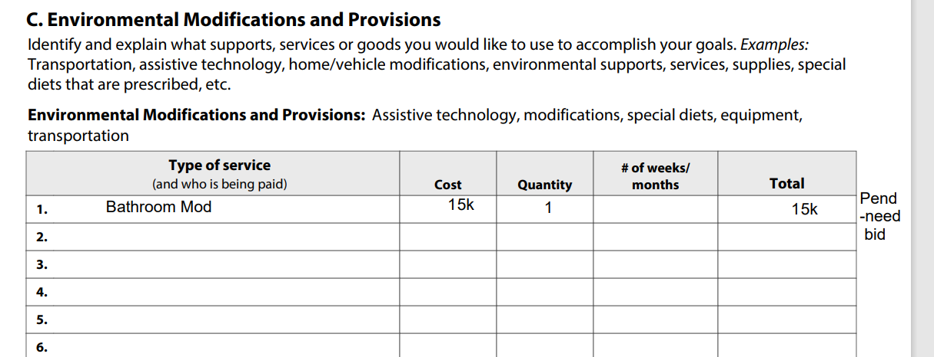
Pending
More Information needed to make an informed decision
Did not submit everything needed
Example would be no submitted bids for EAA or need another one
Did not include explanation
Did not include Alternative Treatment form
Notes:
If something is pending, please note what, why, and what is needed for approval consideration.

Slide 29
Denying (Termination and reduction)
Care Coordinator must:​
complete the Care Coordinator Request for DTR within 24 hours of determination and submit to UM​
Notify member and provider (as applicable) within 24 hours of the determination​
list out each service/item denied/terminated or reduced individually with HCPC T2028 and appropriate “U1-U4” modifier on one form (do not use T2028 as you are not denying CDCS) ​
include comments -no service agreements for service/items being denied/terminated or reduced
When completing a Request for DTR for EW CDCS services or supplies and equipment, “Provider” should be the FMS provider, if one is selected. The member will always receive their appeal rights
Notes:
If a member requested something be reduced or terminated, please also send DTR. In this case, the Home Mod did not have bids and over the EAA EW authorized amount.

Slide 30
CDCS DTR
DTR information can be found on BCBS Website:

Slide 31
CDCS Authorization/Bridgeview
Notes:
Sara

Slide 32
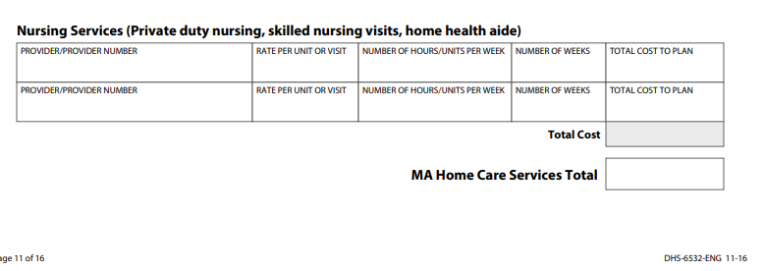
General Authorization information
BCBS does not authorize the max budget, only the up to the approved amount.
All Services must fit and come out of the CDCS budget (including Support Planner, FMS, services, EAA, and supplies/equipment)
EXCEPTIONS include:
CDCS Background
Case Management
If the member uses a Formal EW provider, the provider does not get an authorization
If the member uses Formal MA Home Care Services
They would get an authorization
EXAMPLE: Skilled Nursing approved for 3k
and budget is 30k they could have up to 27k for
T2028
RATIONALE: this is how DHS tracks
Spenddown obligation.
Notes:
The reason we do not authorize the budget max is it is our safeguard to prevent the FMS from paying over the approved amount or paying for something that was not approved. Adult Day providers would need to work with and bill FMS. If using Skilled Nursing, they would get their authorization. If approved for 3k and the max budget is 30,000, that means only 28k should be authorized for the T2028. CFSS agency, just like PCA, can be used with CDCS, but probably not common.

Slide 33
CDCS Background check-T2040
If more than one background check needed, indicate that in the total units authorized.

Slide 34
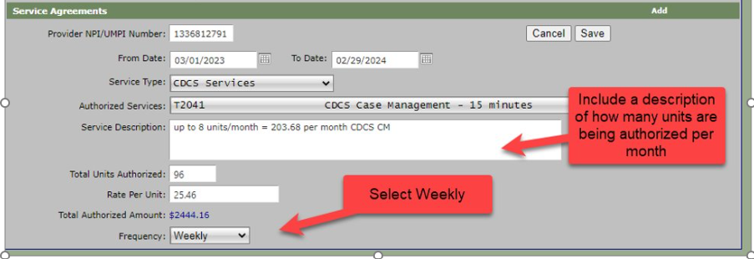
CASE MANAGEMENT-t2041
This is an “up to” the amount that can be used for Care Coordination Delegate billing for required CDCS CM Costs. Delegates billing PMPM would not bill against this service agreement but are still required to enter it.
Notes:
Please note if you’re a county delegate to use your NPI CM number

Slide 35
Cdcs reassessments or the start of a new span
After successfully entering and saving the LTCC & Case Mix History; for members choosing CDCS, the CDCS approved budget amount will be entered into Bridgeview.
Notes:
If approving the plan as requested, this is a great section/resource to use/review.

Slide 36
Bridgeview display screens
Notes:
This is how the authorizations would look in Bridgeview on the LTCC and Case Mix screen and the SA screen.

Slide 37
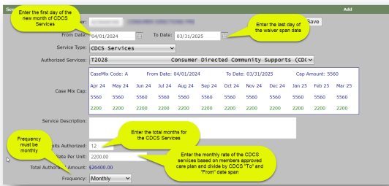
HOW TO ENTER IN BRIDGEVIEW

Slide 38
Cdcs addendum/LEGISLATIVE increases
Add new service agreement(s) in Bridgeview (must add an attestation in service agreement description CSP was reviewed and addendum approved)​
Send an email to request a combination of service agreements into one service agreement: Bridgeview.service.agreements@bluecrossmn.com​
*Note: Since CDCS monthly budget may be used flexibly throughout the waiver span, Bridgeview must be notified to combine the service agreements

Slide 39
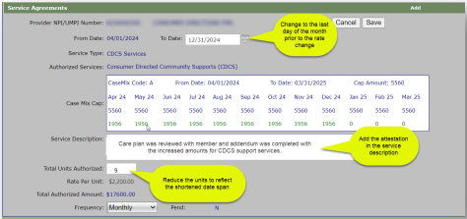
STARTING CDCS MIDSPAN in Bridgeview

Slide 40
How it will look in Bridgeview

Slide 41
CDCS BUDGET MIDSPAN
Member is coming from NH and opening to EW
Case Mix is a B with a max 12-month span of $75,936
Discharge date is 12/5/2024
Assessment was 11/8/2024
Waiver span will be 12/5/2024-10/31/2025
Calculate annual amount for Jan-Oct = $6328 x 10 months = $63,280
Calculate the daily amount for December: $6328/31 (# days in Dec) = $204.13 per day
Calculate the amount based on the number of days for December: $204.13 x27 days = $5511.51 for December
Then add $63,280 (Jan-Oct) + $5511.51(December) = $68,791.51
Notes:
The plan should be signed and approved before discharge. It can only start the day of discharge, so if the discharge is delayed, it would need to be redone. Like with all members, EW services can only be authorized once open to EW or discharged from a hospital/Nursing Home.

Slide 42
CDCS ON SUPPORT PLAN
Notes:
Sara

Slide 43
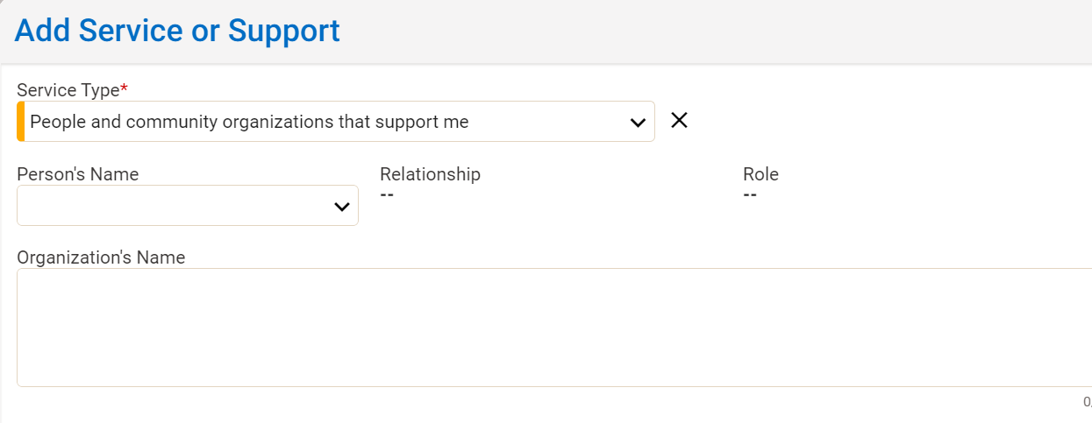
MnCHOICES support plan (How to reflect CDCS)
Complete EW assessment and EW paperwork as required
Services and Supports
T2028 (FMS provider)
Support Instructions: add what
Was approved
Care Coordination/CM T2041
Might put member over the cap; this does not count against the cap/budget for CDCS
If you’re a delegate who does not have a CM number, please put it under People and Organizations that Support Me.
Background check T2040
Might put member over the cap; this does not count against the cap/budget for CDCS
Any formal MA services providers, if applicable (Skilled Nursing, HHA, etc.)
Would need to subtract the amount from T2028
People and Organizations that Support Me
MSHO supplemental benefits
Support Planner***
Supplies and equipment covered by Medicare/Medical Assistance if known
Notes:
Recap is required assessment, paperwork, meeting, and timelines still required with CDCS.
** Example: If a member is receiving a formal support such as MOW, this would be indicated under T2028 and elablorate under the Support Instructions section.

Slide 44
UPCOMING CDCS CHANGES
Notes:
Kim

Slide 45
UNBUNDLING will happen starting 2/1/2025
CDCS "Unbundling" refers to redefining CDCS service categories to keep "like" items together.
Unbundling has been approved by CMS, but not yet implemented by DHS.
Notes:
Unbundling is DHS’s way of redefining the CDCS goods and services categories and this is currently expected to occur beginning on 1/1/2025. As we will see on the next slide, we will go from 4 service categories to 8 categories as a result of this change.

Slide 46
Unbundling Categories- Effective 2/1/2025
Current CDCS service categories:
Proposed Service categories unbundled:
Personal assistance
Treatment and training
Environmental modifications and provisions
Self-direction support activities
Personal Assistance
Treatment and training
Environmental modifications and provisions
Self-Direction Support Activities
Personal Assistance
Treatment and training
Environmental modifications- home mods
Environmental modifications-vehicle mods
Individual-Directed Goods and Services
FMS
CDCS Support Planner
Community Integration and Support
Notes:
On the left are the current service categories, and on the right are the proposed categories. For instance, Environmental modifications will be split into 2 separate categories- home modifications and vehicle modifications, whereas now they are bundled into just one Environmental modification category. In addition, there will now be a specific category for goods and services, FMS, Support Planner and Community Integration and Support.

Slide 47
UNBUNDLING effective 2/1/2025
DHS to publish updated web information including:
Policy pages and forms
Online learning modules
The Unbundling process will be a rolling implementation.
Current CDCS participants will:
Continue their current CDCS plan through the remainder of their plan year
Transition to an unbundled CDCS CSP at next reassessment
Notes:
As you see, this will be a rolling implementation. Members will continue their current CDCS plan through the remainder of their current plan year, at which time they will transition to the new categories at their next reassessment.

Slide 48
CDCS Resources
Notes:
Kim

Slide 49
CDCS Resources
Please see the CDCS Resource on our Care Coordination Website for additional Resources.
Notes:
** The current Resources will always be displayed on our website at this location. As a reminder, please always use the website for the most current information, and do not save to your desktop.

Slide 50
thank you
Notes:
Questions??

