Slide 1
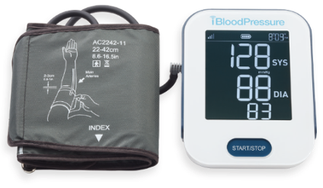
Blood Pressure Monitoring
How Does the BP Monitoring Benefit Work?
Member receives BP device
This device is theirs to keep - no need to return
Monthly Monitoring Service
Initial intensive telephonic outreach in month 1 & 2 to drive compliance of the device (encourage use)
On-going BP text alerts notifying members when BP is out of range
Caregiver or member can receive text alerts
Member can provide BP threshold or use a standard threshold from BCBS
Device Support
Provided by QMedic customer service team

Slide 2
Blood Pressure Monitoring
QMedic Non Compliance Notifications -
QMedic will notify CC if member is not utilizing BP service
No BP first reading notifications (device never used)
No BP readings within 2-months
When Should Monthly Monitoring Be Discontinued?
Member does not utilize device (no first reading)
Member does not regularly test BP
It is at the CC’s discretion to decide if member should continue with BP monthly monitoring services

