Slide 1
Medicaid Population Health Strategy & roadmap
Marie Malinowski, Principal Program Manager, Medicaid Population Health
August 2024

Slide 2
Welcome!
Learning Objectives for this Training
Participants will be able to define and understand Population Health
Participants will better understand how Population Health and data guides our programs and interventions to improve member outcomes
Participants can leverage this information as a tool to evaluate and share information about their communities to improve member outcomes

Slide 3
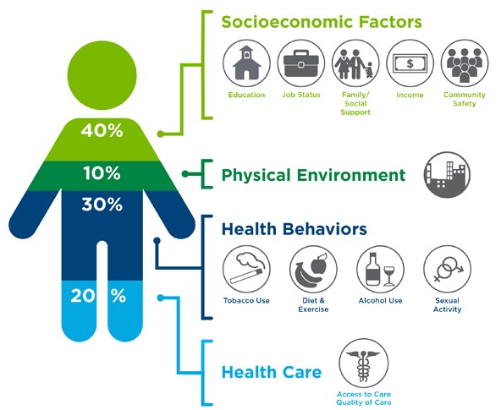
What is population health?
Definition: A strategic framework to improve the outcomes of a defined group of people and informs a model of care for addressing individuals’ comprehensive health needs.
People: Race & ethnicity, age, gender, gender identity, disease or condition, and genetics.
Factors that contribute to health: Environmental, geography, income, employment, safety, education, etc.

Slide 4
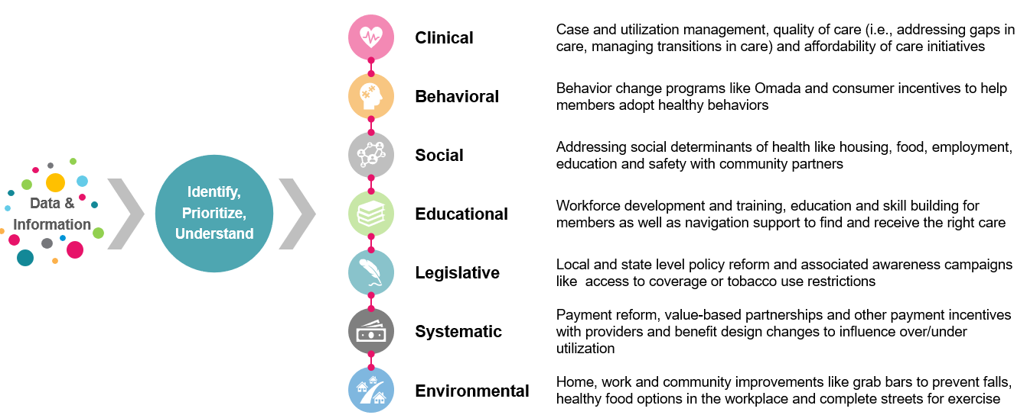
What is population health?
Interventions: Clinical, behavioral, social, educational, legislative, systematic or environmental.
Outcomes: health (equity, morbidity, mortality), experience, wellbeing, quality of life

Slide 5
The continuum of health
To increase our impact in supporting consumer health and cost sustainability, we focus and connect the efforts from upstream to downstream.

Slide 6
PHM Strategy: integrating data to inform intervention
Our Population Health design process follows a continuous improvement cycle to determine root causes and engage stakeholders in the design of interventions and actions. This process best positions our interventions to meet the needs of our members and ultimately be successful in maintaining and improving health, well-being, and quality of life.
Population Assessment
Chronic condition management
Growing Food Insecurity
Ongoing 2x/ week check-ins
Identify issues early
Adapt as we learn
Research Opportunity
Developed Logic Model based in clinical research evidence
Design Intervention
Example Healthy Food Program
Nutritional intervention for seniors
Incorporated real-world learnings from other programs
Scalable process = Cross-organizational collaboration to identify future opportunities
Clinical Expert Reviews
Cross Functional Team
Member Feedback
Multiple iterations
Identify the Problem
Identify Success Metrics
Implement

Slide 7
Examples of current Population Health Interventions in Flight
Focus Area | Program | Description | Population Health Lever(s) | Targeted Population | Measurable Goal | How Members are Informed
Patient Safety & Outcomes Across Settings | Community Health Worker Hubs | Live Well Winona and Mankato Hub | Clinical Behavioral Social Educational Environmental | Members experiencing a barrier related to SDOH in Winona, Mankato and Twin Cities | Increase number of members screened for SDOH. | Care Coordinator Provider referral
Keeping Members Healthy | Odam Medical Group Mobile Clinic | Mobile clinic collaboration to bring medical care to members in their homes | Clinical Behavioral | Members in Stearns, Wright, Benton, Sherburne, Clay, Crow Wing, Otter Tail, Cass, Wadena, Todd, Morrison, Mille Lacs, Kanabec, Meeker, Kandiyohi, & Becker counties | Member satisfaction Close gaps in care | Outreach from Odam Blue Plus member postcards
Managing Members w/ Emerging Risk | Omada | Virtual program with one-on-one health coaching, specialist support and smart devices to help members manage diabetes, lower blood pressure or lose weight | Clinical | Members with pre-diabetes, diabetes, hypertension & obesity | Diabetes Average weight loss Average A1C reduction % of participants who hit 5% weight loss goal % of participants who hit A1C goal Hypertension Average blood pressure reduction Change in blood pressure hypertension categories % of participants who hit BP value or category target (see documentation for targets) | Email, postcards Care Coordinator Blue Plus website
Managing Multiple Chronic Illnesses | Healthy Food Benefit | Tailored meal delivery program in collaboration with NourishedRx to provide nutrition education and resources for chronic conditions. | Clinical | MSHO members diagnosed with chronic conditions such as pre-diabetes and diabetes, cardiovascular disease and/or hypertension. | CDC Healthy Days (self-reported) Diabetes Distress Scale (check w/ Nourished Rx) Patient Activation Measure Reduced gaps in care Fewer avoidable and diabetes-related ER visits (claims) Fewer in-patient stays (claims) Total pharmacy spend | Direct outreach by vendor based on eligibility file from Blue Plus

