Slide 1
Cultural Competency Culture Care Connections
Rosemond Sarpong Owens
Director, Racial and Health Equity

Slide 2
Racial & Health Equity - Our desired outcome and declared process*
Racial Equity as both an outcome and a process.
As an outcome, we achieve racial equity when race no longer determines one's socioeconomic outcomes; when everyone has what they need to thrive, no matter where they live. As a process, we apply racial equity when those most impacted by structural racial inequity are meaningfully involved in the creation and implementation of the institutional policies and practices that impact their lives. (Race Forward)
Health Equity is the attainment of the highest level of health for all people.
Achieving Health Equity requires valuing everyone equally with focused and ongoing societal efforts to address avoidable inequalities, historical and contemporary injustices, which include systemic racism, and the elimination of health and health care disparities. (Healthy People 2030)
Racial & Health Equity
We work to eliminate the entrenched racial & health impacts and inequities of systemic racism on our members and the state of Minnesota. We achieve racial & health equity when race no longer determines health outcomes nor the healthcare preventive measures or remedies accessible to Black, Indigenous and People of Color. Racial & Health Equity is the attainment of the highest level of health for all people.
As our desired outcome
We actively center race in the anti-racist investigation of our mindsets, structures, patterns of behaviors, and events that perpetuate racial & health inequities. We apply a racial & health equity lens to our work that centers those most marginalized by systemic racism to ensure authorship, leadership and ownership** of mitigating initiatives for racial & health equity.
As our declared process
BCBSMN/Stella will transform health care by implementing racial & health equity to become the statewide-sector leader and community-confirmed partner at eliminating racial and health inequities in an authentic, collaborative, data-driven, community-centered approach for the state of MN and our BCBSMN members with proven outcomes.
*Adapted from racial equity definition (Race Forward) and health equity definition (Healthy People 2030)
** Nexus Community Partners concept

Slide 3
Our Racial and Health Equity Ethos and Core Beliefs
ETHOS
“If you have come here to help(save) me, you are wasting your time. But if you have come because your liberation is bound up with mine, then let us work together.”
Lilla Watson & Aboriginal Rights Group, Queensland, Australia
Racism is a Public Health Crisis.
We will center race as we work to undo its negative impact on our members, our enterprise & our state.
Community has the answers.
We will partner in a way. authentic, collaborative, community-centered
Be Bold and Do Different.
We will courageously face this crisis and the factors that enabled it while changing the ways we work to get different (better) outcomes.
Shared Liberation.
Community and enterprise both benefit and are transformed from elimination of racial and health inequities.
Philosophical Foundation of Racial & Health Equity
What would liberation look like for BIPOC Communities?
What would liberation look like Blue Cross Blue Shield of Minnesota?
BELIEFS
Shared Liberation

Slide 4
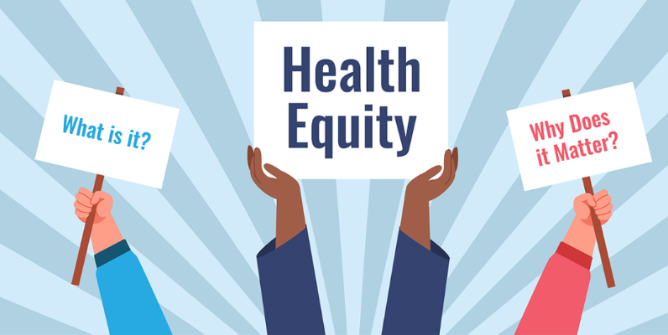
Culture Care Connections
Health disparities due to race, ethnicity, gender, disability status, LGBTQ status, and more create devastating and costly inequities in our healthcare system.
They lead to social and economic hardships that impact our whole society, including increased crime, higher healthcare costs, and vulnerability to pandemic disease.
Health disparities can be traced in part to unconscious/implicit bias and a lack of provider cultural competency.
What can you do about it?

Slide 5
Cultural Competency Resources Overview
One way is through the Culture Care Connection, an online learning and resource center that supports clinical and non-clinical health care professionals to reduce health disparities and promote health equity.
Tools and resources in four key areas focus on building skills, knowledge, and commitment to action for individuals and organizations to:
Recognize and address biases that can lead to inequitable care.
Provide culturally responsive care to support positive health outcomes and meet patient needs.
Explore and use data resources to drive action that will support the delivery of equitable and effective health care and services.
Understand how social determinants of health affect individuals and communities and take action to address their impact.

Slide 6
Learning Outcomes
Understand the myriad of resources available within the site
Discover creative ways that you can leverage these resources
Engage in Continuous Learning
Keep yourself informed
Stay current on health equity, disparities, anti-racism work and discuss as a group
Identify opportunities to incorporate what you learn into your work

Slide 7
Notes:
Presenter: Dr. Mark Steffen
Time Allotment: 10 minutes
Dr. Steffen will give us a brief overview of the RHE key 2022 accomplishments and provide an overview of the 2023-2025 strategic framework we will be using as we move forward.
Next Slide: 2022 Key Accomplishments

