Slide 1
Bridgeview Tuesdays Back to Basics
Janet Siegel, Ruth Finch, Becky Ridley & Partner Relations Team
03/12/2024

Slide 2
Agenda
Introductions
Bridgeview Resources
Changes and Updates
Care Coordination Home Page
Member Detail Screen-
EW Service Agreements- Wipes, ensure and others…
State Plan Service Agreements
PCA Services
SNV – RN and LPN
Modifying State Plan Services
Questions-

Slide 3
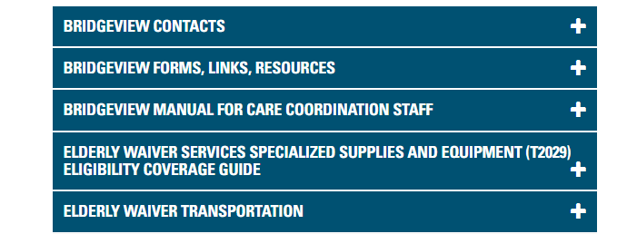
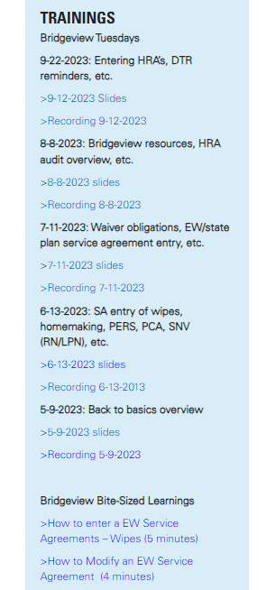
Resources
Care Coordination Website
Care Coordination Guidelines
Request for DTR form
Bridgeview Page
Bridgeview Communications
Bridgeview Web Tool User Access Request Form
Bridgeview Care Coordination User Guide
Member360 (M360) Manual
T2029 Guide for Care Coordinators
DME Payor Determination Checklist
Service Agreement Provider & Member Reason Codes
EW Transportation
MSHO Page
MSHO Supplemental Benefit Referral Forms

Slide 4
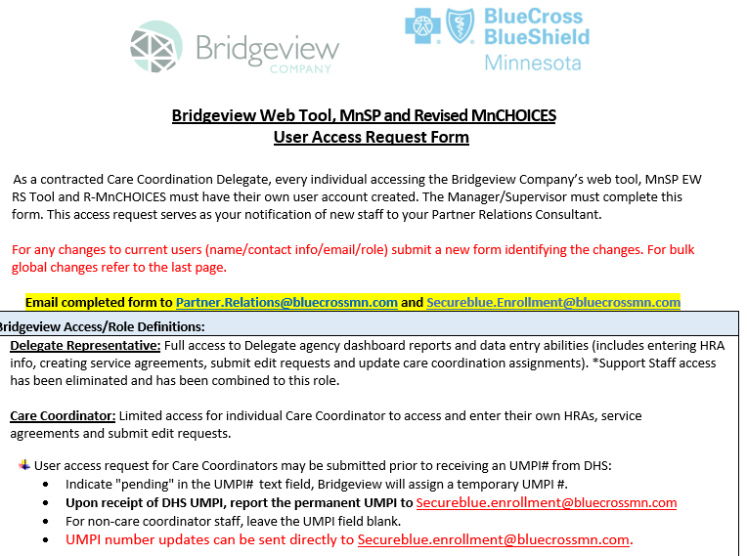
Access Requests- Bridgeview, R-MNChoices and MNSP
Please submit all access request to Secureblue.enrollment@bluecrossmn.com. This includes adds, terminations and updates.
When requesting any access adds, terms or changes, complete the Bridgeview Web Tool, MnSP and Revised MNChoices User Access Request form (shown below). You will need to complete one form per request (we no longer accept multiple security requests on one form). This form can be found on the Care Coordination Site: https://carecoordination.bluecrossmn.com/mnchoices/ Under the access Request Form dropdown.

Slide 5
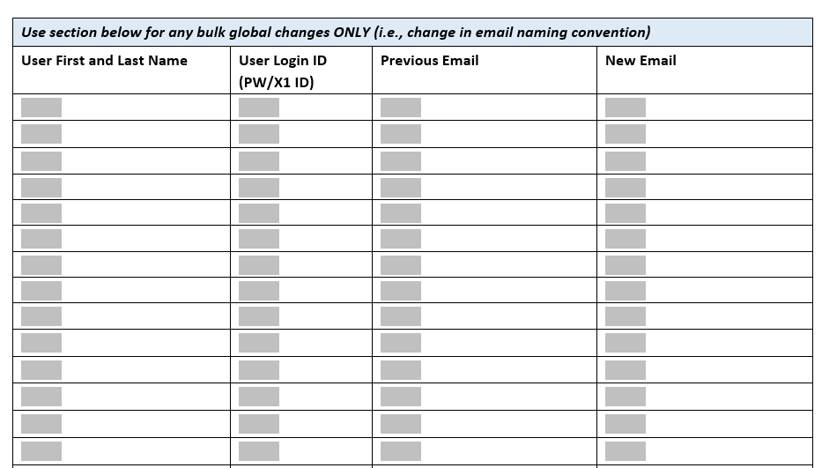
Access requests for bulk changes
If requesting bulk email changes, complete the second page of the Access request form completely.

Slide 6
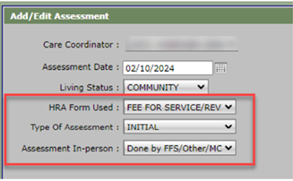
Bridgeview Assessment Entry
Please make sure to choose the correct option under the Assessment In-person dropdown when entering assessments in Bridgeview
The options are:
Yes
No
Done by FFS, Other, MCO, Unknown

Slide 7
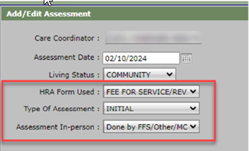
Add /Edit Assessment
To Avoid Gaps in Waiver coverage, Care Coordinators must confirm the actual date of the in-person assessment when determining your annual re-assessment

Slide 8
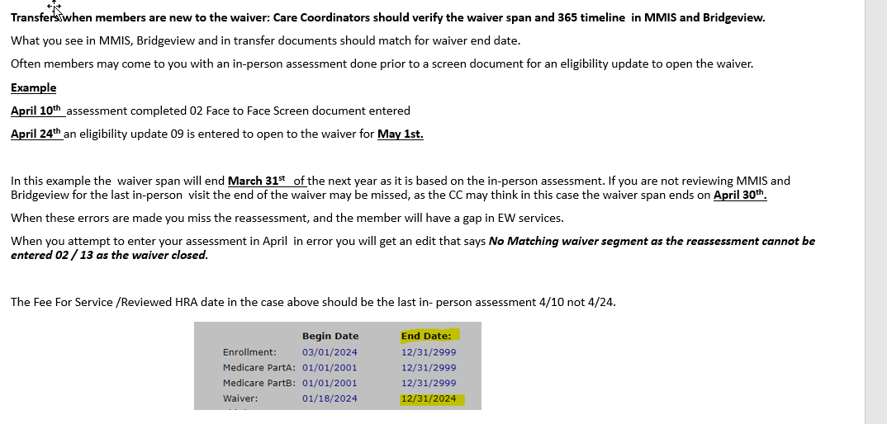
New Members with Elderly Waiver Span

Slide 9
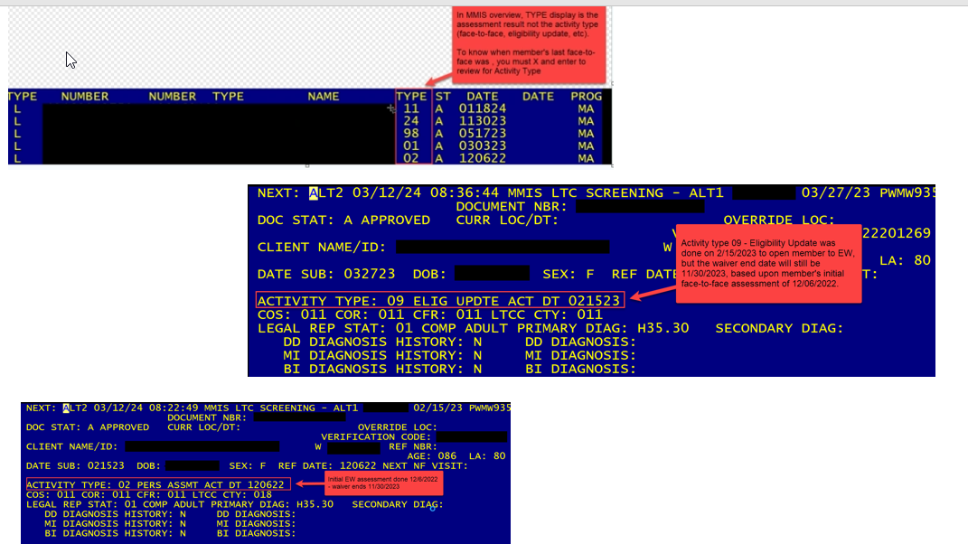
New Members with Elderly waiver span

Slide 10
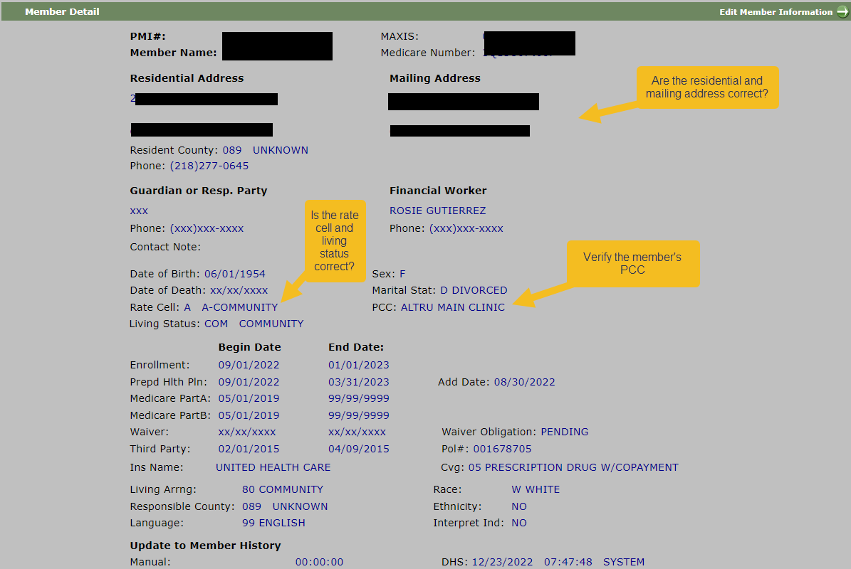
Member detail screen- don’t forget to review

Slide 11
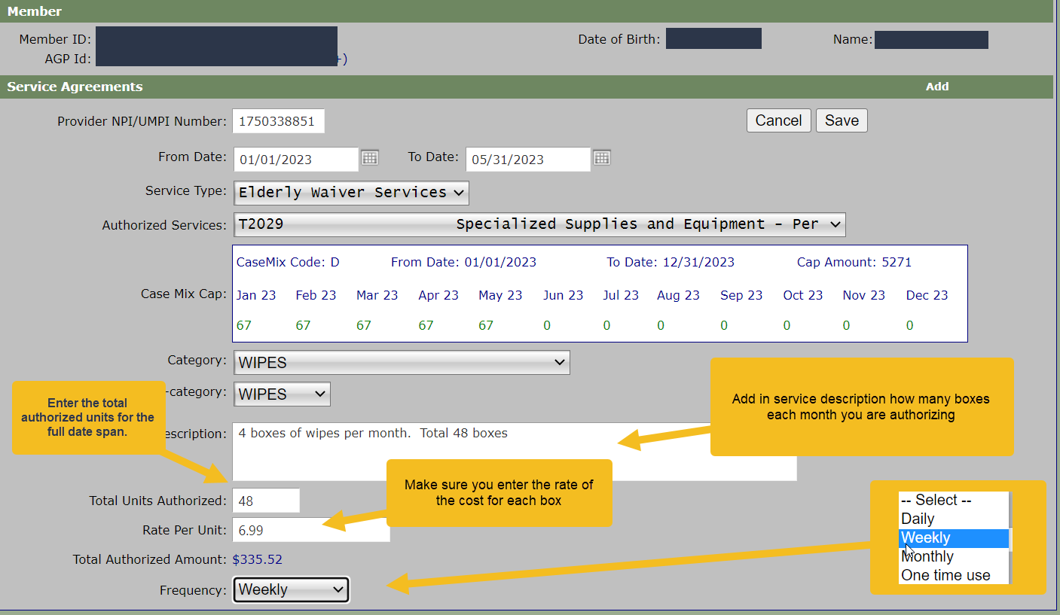
Bridgeview EW Service Agreements- WIPES

Slide 12
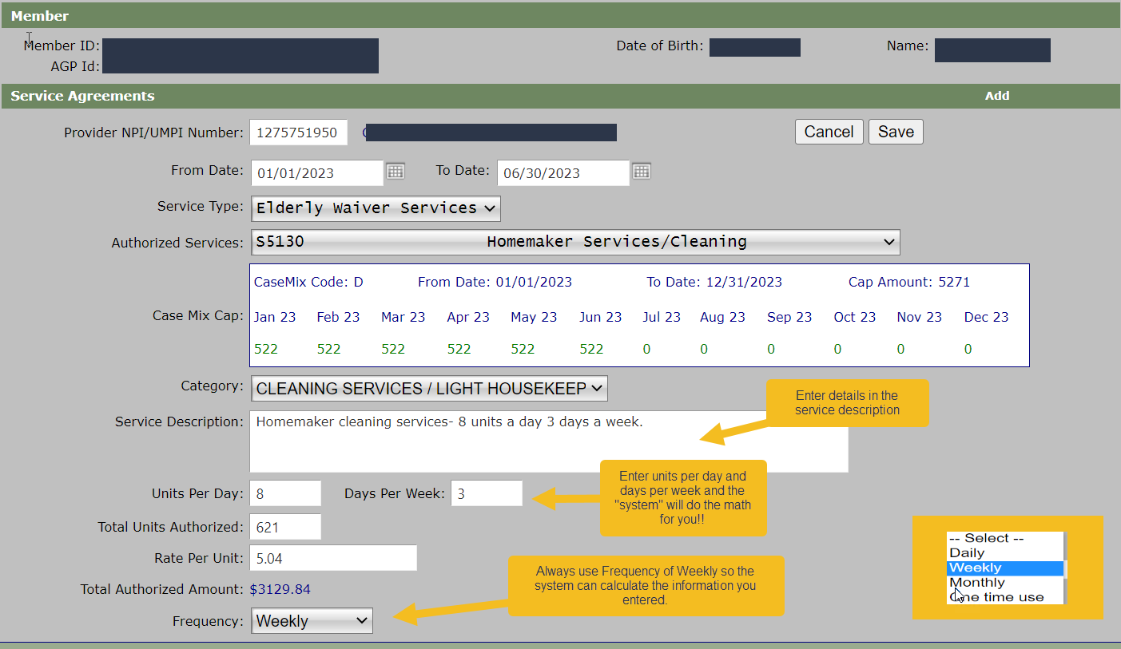
Bridgeview EW Service Agreements- Homemaker

Slide 13
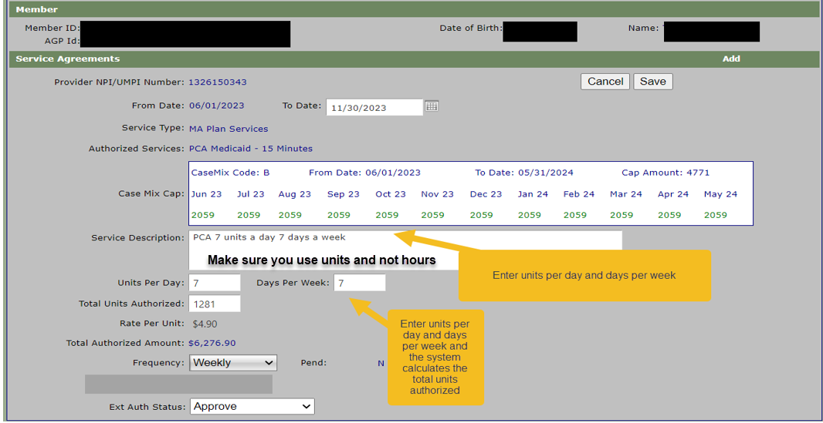
State MA Plan Services – PCA 1st Entry

Slide 14
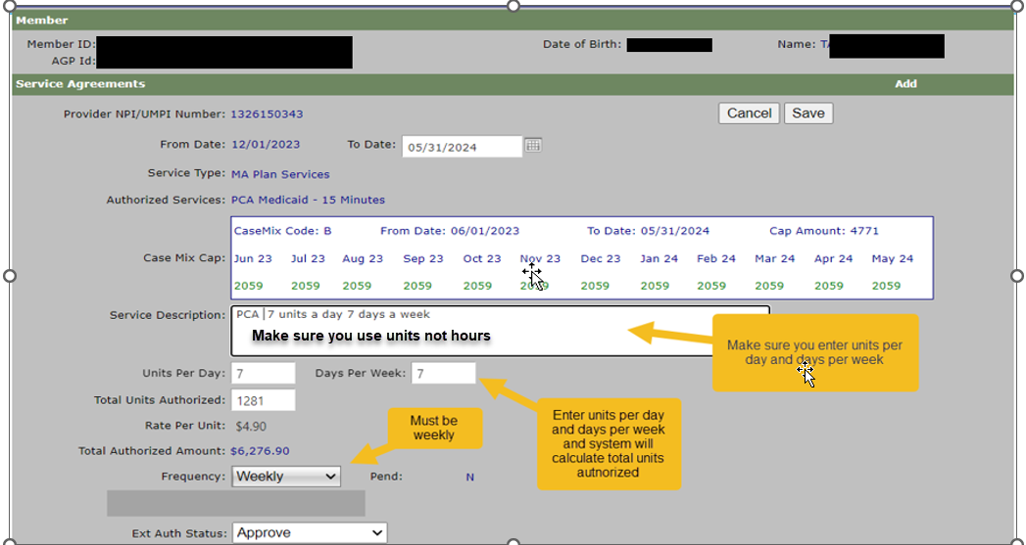
State MA Plan Services – PCA 2nd Entry

Slide 15
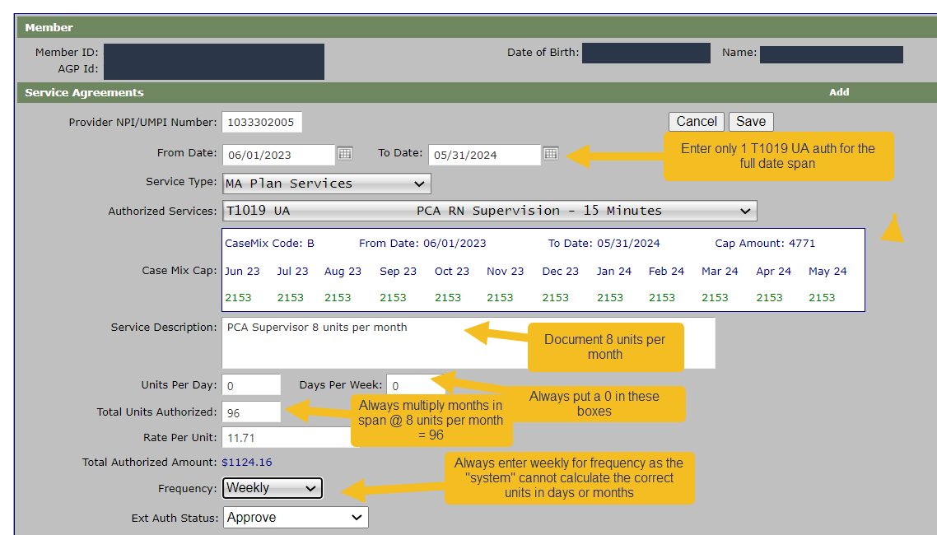
State Plan PCA Supervisory Authorization

Slide 16
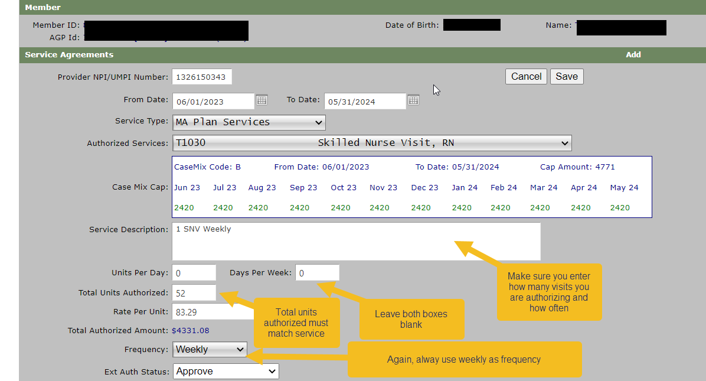
State MA Plan Services – SNV- RN

Slide 17
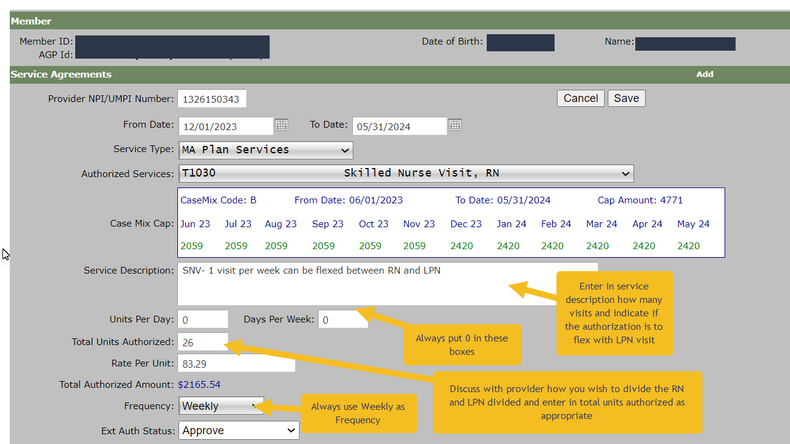
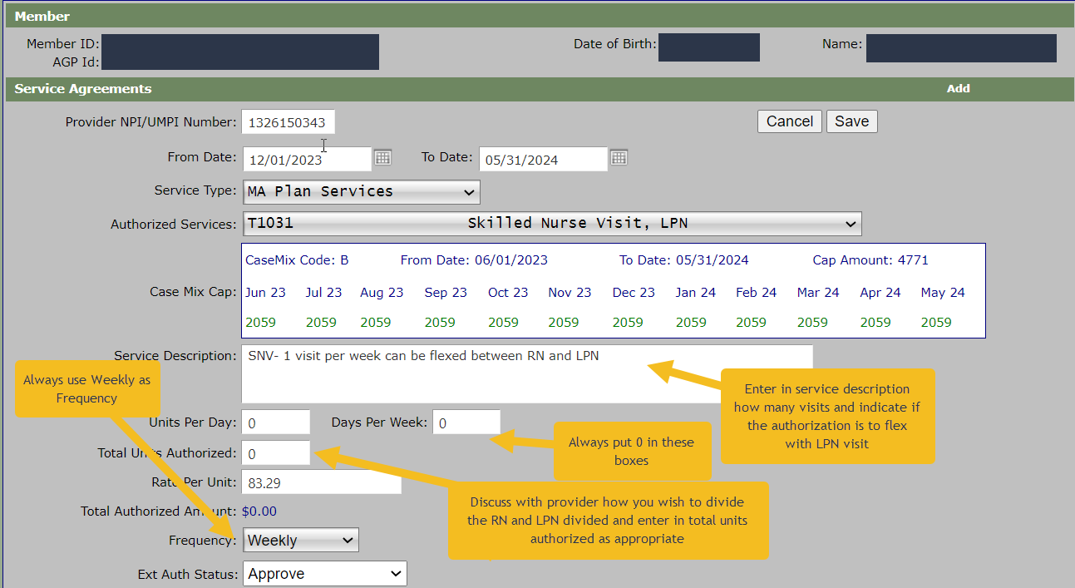
State Plan SNV RN and LPN Flex Units

Slide 18
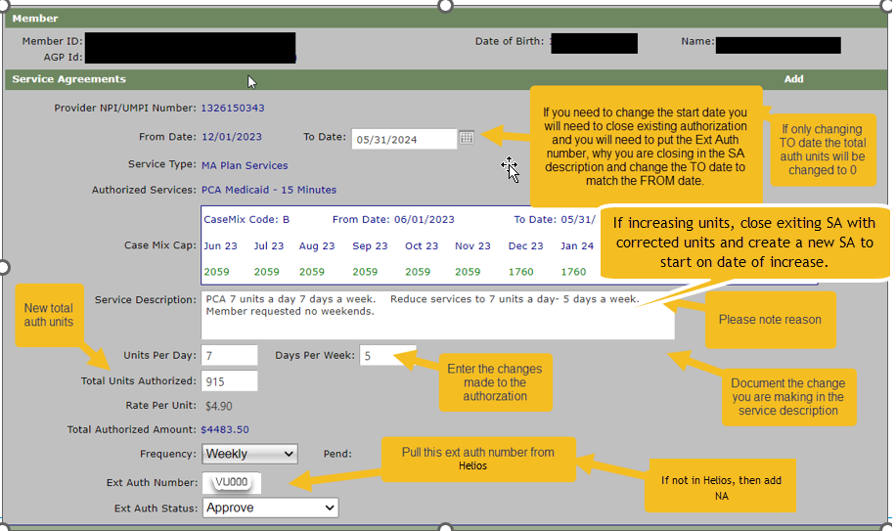
State Plan Services- Modifying existing
Please note:
Do not change any authorizations until you receive a completed DTR request from UM team with the official end date.

Slide 19
Modifying an existing State Plan Authorization
Access Helios to view current member authorizations.
Get the “VU” authorization number-Not the Bridgeview SA number.
Note the date span on existing authorization.
Select the state plan service agreement that needs to be modified in Bridgeview.
Click view and then modify. (cannot modify start date or service code)
Update the current service agreement by modifying end date and verify the total units approved coincide with the end date. Must update the service description that match the changes.
Note: if you are decreasing service DTR is required.
Enter the Helios authorization number in the Ext Auth number box.
Click to Save your changes.
Once you made your update CHECK YOUR WORK to make sure the changes are correct.
If your modification is due to an increase in services, then close existing service agreement and create a new one.

Slide 20
Tidbits for MA State Plan Service Authorizations

Slide 21
Tidbits for MA State Plan Services- PCA
Make sure to note in the service description units per day/days per week.
You must choose the frequency of weekly for all PCA authorizations. (If you choose monthly – the system automatically defaults to 1 unit per month – if you choose daily, it will default to 1 unit per day)
When making multiple authorizations, you can use the copy tab – just make sure you are changing all the needed information.
Any PCA authorization must have a RN Supervision authorization for the full span of the PCA services (enter for the whole span do not split)
When you modify the dates on the authorization – please make sure you are validating that the units are still in the boxes – if you modify the date on an entry, the system automatically deletes the approved units, so you need to make sure the units are updated also.

Slide 22
Tibits for MA State Plan Service- SNV & HHA
SNV – CC is only authorized to approve up to 52 units (1 visit per week) for both RN and LPN combined. Anything over 52 units – you must select “Request for Review” in the bottom box.
If you want the RN and LPN to be shared services, you must create 2 separate authorizations – a T1030 and a T1031 with the number of units divided between the two services and note in the service description that these units will be shared by RN and LPN
Home Health Aide – CC is only authorized to approve 156 units (up to 3 visits per week) per year. Anything over 156 units, you must select “Request for Review” in the bottom box.

Slide 23
Questions
For process related questions, contact your Partner Relations Consultant or email: Partner.Relations@bluecrossmn.com
For technical questions related to entering service agreements, contact the Bridgeview Team: Bridgeview.service.agreements@bluecrossmn.com

Slide 24
Thank ou!!!

