Slide 1
Bridgeview Tuesdays February 2024
Janet Siegel, Ruth Finch & Partner Relations Team
02/13/2024

Slide 2
Agenda
Introductions
Bridgeview Resources
Membership
MA State Plan Auths
S5121 Chore Service Daily
Questions
Resources

Slide 3
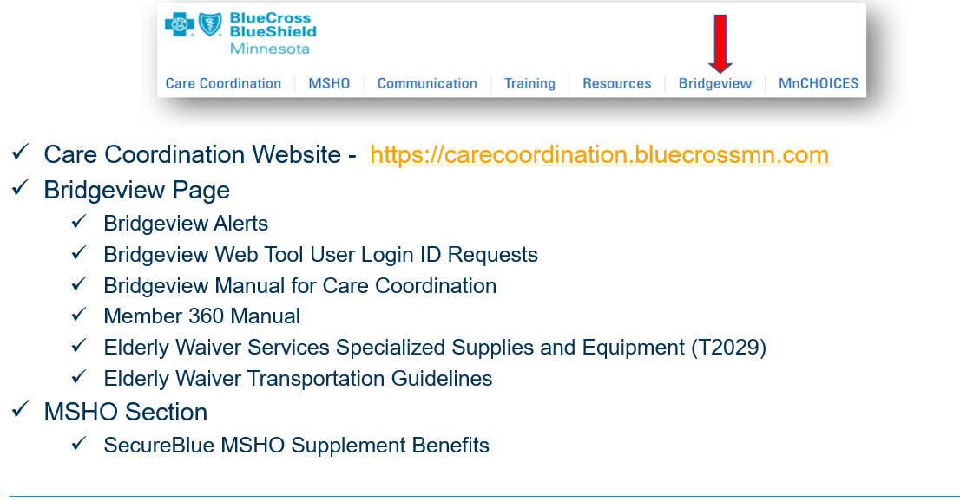
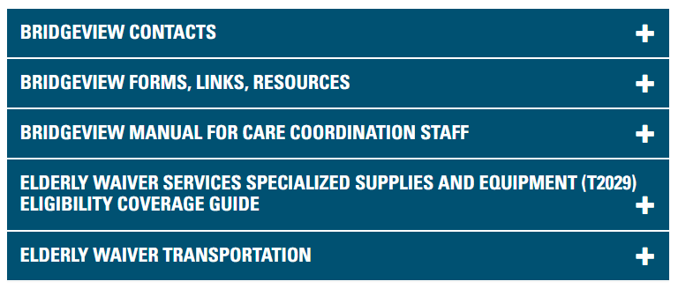
Bridgeview Resources
Care Coordination Website: https://carecoordination.bluecrossmn.com/
Bridgeview Page: https://carecoordination.bluecrossmn.com/bridgeview/

Slide 4
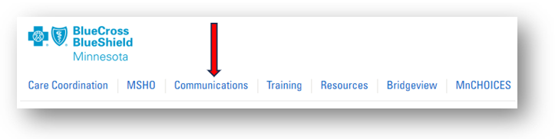
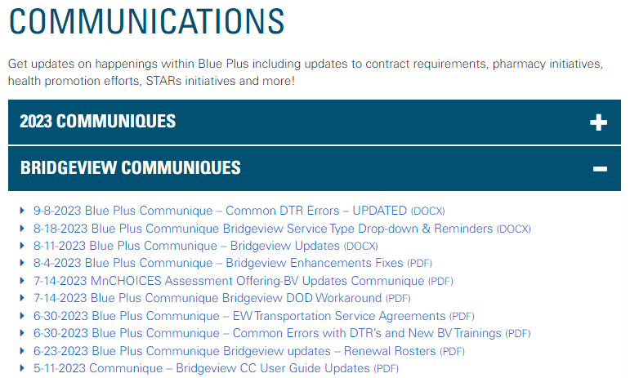
Bridgeview Resources

Slide 5
Bridgeview Membership
Bridgeview receives daily enrollment updates that includes CMS daily updates
Contacts on the Delegate primary contact list will receive an email for all agency reports in Bridgeview regarding enrollment.
All enrollment reports will display member term dates for DOD and MA terms.
Daily enrollment (Day) reports will continue for new member adds, terms and product changes. An email notification will be sent if you have a daily enrollment report.
Its unknown how often that MNITS is updated to reflect the member’s current enrollment status based upon CMS updates.

Slide 6
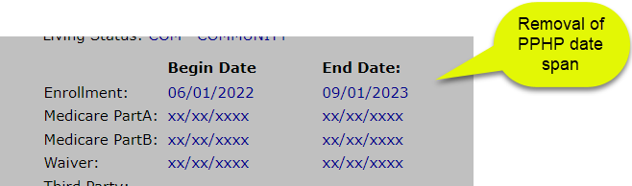
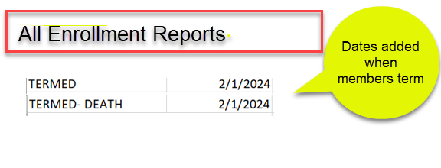
Bridgeview Changes for 2024
Notes:
Removed the PPHP date span because we only get this record from DHS the last week of each month and an reinstate the first of the new month. This why it is so important to communicate with the member’s service providers that MA is termed and its possible they might not get reimbursed for services if the member is not reinstated after their MA term date (Elderly Waiver and PCA)
If you done your due diligence on completing assessments with the member accessing EW or PCA services during the known grace period date span and the member is termed you can notify the PR team and Bridgeview will process care coordination claims related to the member’s assessment completion. IF this step is missed the claim will be rejected.

Slide 7
Cate – MA State Plan Slides
STATE PLAN AUTHORIZATIONS WITH SERVICE START DATE OF 1/1/24 OR AFTER:
State Plan Home Care (PCA, HHA, SNV) authorization files are sent from Bridgeview to Utilization Management (UM) daily for data entry into Helios.
UM has 10 business days from the date they receive the Bridgeview File to enter auths into Helios.
If a provider is asking about an authorization or PA, first verify the date the SA was entered into Bridgeview by hovering over the green “view” arrow.
Notes:
EW claims will continue to be processed out of Bridgeview. At this time, EW Service Agreements (SAs) will not be displayed in Helios.

Slide 8
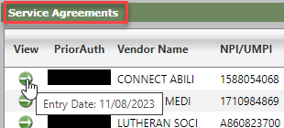
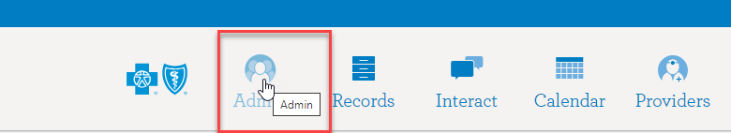
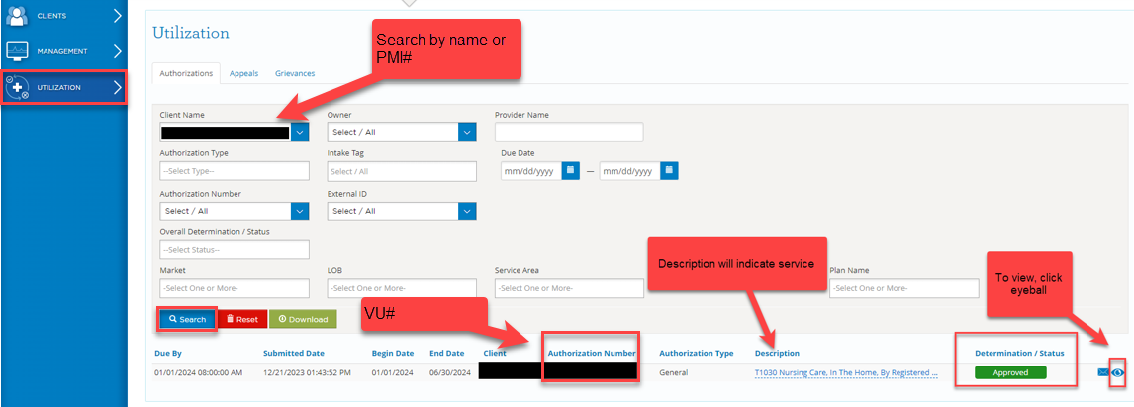
Cate – MA State Plan Slides
After logging into Helios, click ADMIN.
To access Authorizations, click Utilization from the menu on the left.
Notes:
If the SA was entered into Bridgeview 10 or more business days ago, next, check Helios – Utilization Management for the authorization number.

Slide 9
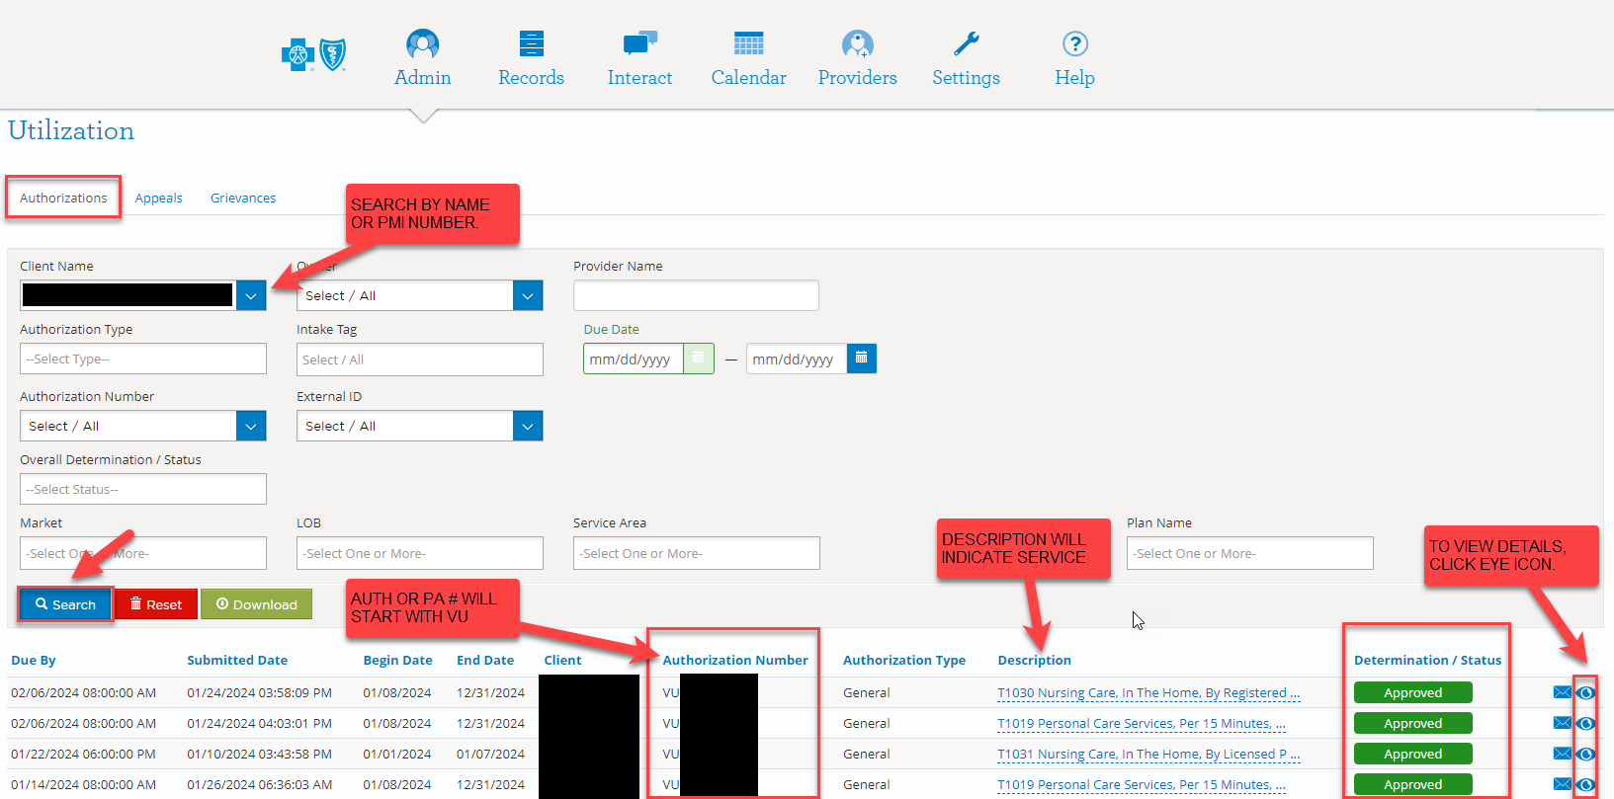
Cate – MA State Plan Slides
Notes:
In the client name field, users can search by member’s last name/first name or by PMI#. Next, click the blue search button.
If the member has authorizations that have been processed by UM, regardless of the determination/status, they will display below the search criteria as see above.
The following information will display in this overview: Begin and end date, client name, authorization number, authorization type, description, and determination/status. Determination/Status options are: approved, voided, pended, or denied.
To view details and or a copy of the documentation sent to the member and provider, click the EYE icon at the far right.

Slide 10
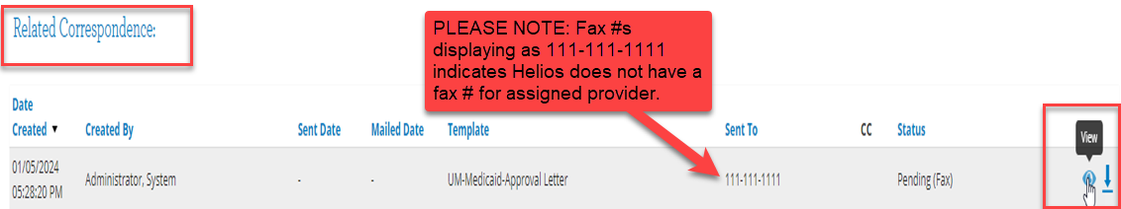
Cate – MA State Plan Slides
Once in the member’s record, scroll down to Related Correspondence.
Notes:
Click the EYE icon next to the document you wish to view. This will then display a copy of the letter that was sent to the provider or member.
Please note: Providers will receive a mailed copy of their authorization or PA. For providers to receive a faxed copy, Care Coordinators should include the fax number in the Service Description field of the Bridgeview Service Agreement. If this information is included, the UM Team will add the provider’s fax number and the authorization will then be faxed as well as mailed to the provider.

Slide 11
Cate – MA State Plan Slides
If Helios does not display authorization information and it has been 10 business days or greater since SA info was entered into Bridgeview, securely email member’s information, including PMI#, to Bridgeview.Service.Agreements@bluecrossmn.com
  Bridgeview Service Agreement staff will work with Helios UM staff to resolve.
  When correction(s) have been made, Bridgeview Service Agreement staff will follow up with the Care Coordinator and provider via email.

Slide 12
Cate – MA State Plan Slides
STATE PLAN AUTHORIZATIONS PREVIOUSLY ENTERED INTO BRIDGEVIEW AND PROCESSED BY AGP
Providers will not receive a new authorization letter from Blue Plus for auth(s) previously sent out by AGP for services with start dates in 2023, extending into 2024. Providers can continue to bill off of auths received from AGP. Claims will pay for dates of service as authorized. Regardless of dates of service, Providers must use members’ new Subscriber ID, including prefix, when submitting claims. MSC+: MQG8+PMI MSHO: MQS8+PMI Additionally, regardless of dates of service, Providers must also use new payer ID 00726 when submitting claims. IMPORTANT: If a Provider did not receive an authorization from AGP for a service with a start date of 2023, Care Coordinators securely email member information, including PMI#, to Bridgeview.Service.Agreements@bluecrossmn.com Bridgeview Service Agreement staff will work with Helios UM staff to resolve. When correction(s) have been made, Bridgeview Service Agreement staff will follow up with the Care Coordinator and provider via email.

Slide 13
Cate – MA State Plan Slides
Providers can be sent to the following Blue Cross website for information on the migration. https://www.bluecrossmn.com/providers/migration-minnesota-health-care-programs-mhcp Care Coordinators can also direct Providers to call Provider Services at 866-518-8448. Providers will need their applicable Helios VU authorization number if they want to receive a copy of their authorization. IMPORTANT: Blue Plus is currently working on resolving authorizations that are being reported to us with missing information. Missing info may include service codes, description, and units. If Care Coordinators are aware of authorizations that are missing the above information, please securely email Bridgeview.Service.Agreements@bluecrossmn.com

Slide 14
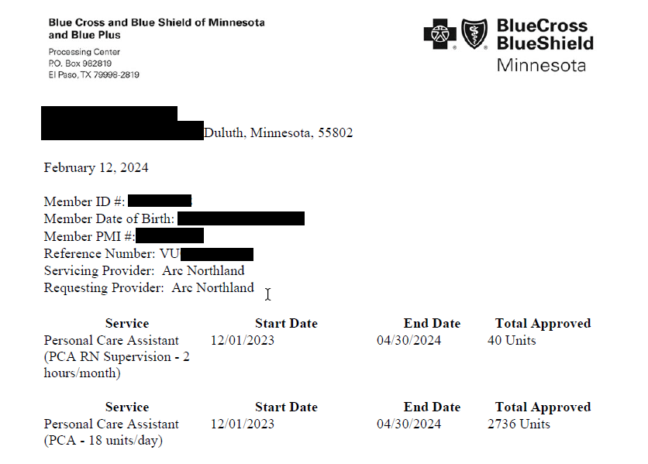
Cate – MA State Plan Slides
Notes:
This is an example of an updated authorization.

Slide 15
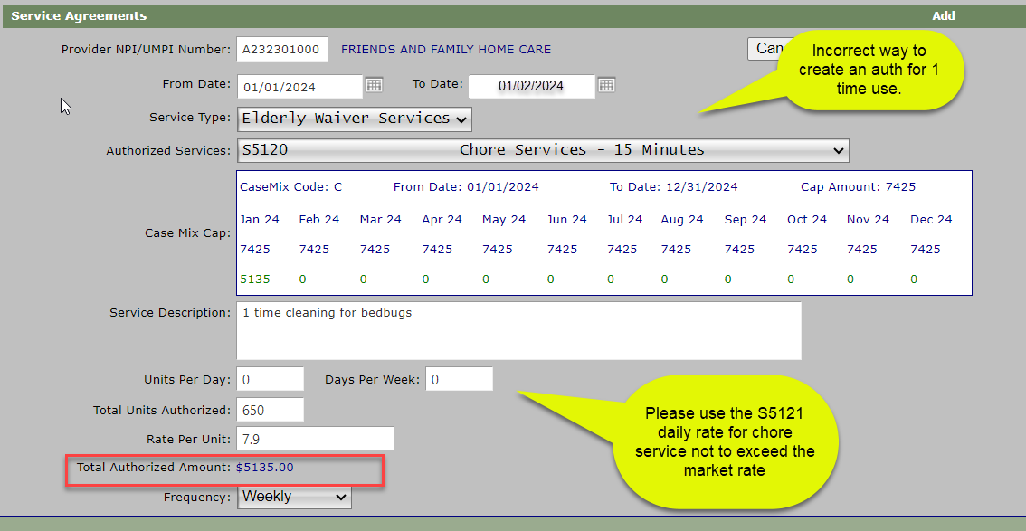
S5120 Chore Service – 15-minute entry error
Notes:
If you are finding your self in this situation you should consider using the S5121 daily chore rate. As you can see this is only authorized for 5 days… it will exceed the units

Slide 16
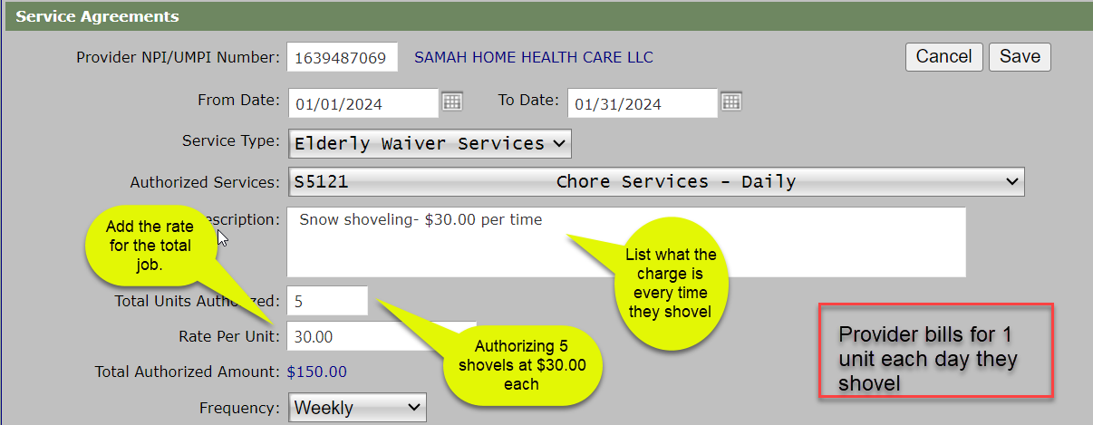
S5121 Chore Services Daily Rate

Slide 17
Questions
For process related questions, contact your Partner Relations Consultant or email: Partner.Relations@bluecrossmn.com
For technical questions related to entering service agreements, contact the Bridgeview Team: Bridgeview.service.agreements@bluecrossmn.com

Slide 18
Resources
Care Coordination Website
Care Coordination Guidelines
Request for DTR form
Bridgeview Page
Bridgeview Communications
Bridgeview Web Tool User Access Request Form
Bridgeview Care Coordination User Guide
Member360 (M360) Manual
T2029 Guide for Care Coordinators
DME Payor Determination Checklist
Service Agreement Provider & Member Reason Codes
EW Transportation
MSHO Page
MSHO Supplemental Benefit Referral Forms

Slide 19

Image Credit: https://www.employeeconnect.com/blog/thank-you-to-employees/

