Slide 1
2024 Odam Mobile Clinic Bringing healthcare to hard-to-reach and high-risk populations in Medically Underserved Communities
Marie Malinowski, Principal Program Manager, Medicaid Population Health

Slide 2
State of affairs
Living in a rural area has been recognized as a unique health disparity¹, resulting in higher rates of chronic disease, lack of access to mental health care, and higher rates of terminal illnesses^{2,3}.
Racial, ethnic, immigrants and linguistic minority people experience, or have experienced, historical trauma, provider bias, prejudice, and systemic discrimination, which influences and impacts how they seek and receive healthcare and how healthy they are⁴.
Cultural competency is an essential consideration in addressing health disparities.
Health outcomes are only the tip of the iceberg
Systemic racism
Transportation barriers
Provider bias
Historical trauma
Zip code
Environment
Employment status
Poverty
Language proficiency
Healthcare access barriers
1. Healthy People. [(accessed on February 17, 2022)];2020 Available online: https://www.healthypeople.gov/2020/about/foundation-health-measures/Disparities. 2. Trout K.E., Chaidez V., Palmer-Wackerly A. Rural-Urban differences in roles and support for community health workers in the Midwest. Fam. Community Health. 2020;43:141–149.
3. Coughlin S.S., Clary C., Johnson J.A., Berman A., Heboyan V., Benevides T., Moore J., George V. Continuing challenges in rural health in the United States. J. Environ. Health Sci. 2019;5:90–92. 4. Castañeda H., Holmes S.M., Madrigal D.S., DeTrinidad Young M., Beyeler N., Quesada J. Immigration as a social determinant of health. Annu. Rev. Public Health. 2015;36:375–392.
Lack of culturally-concordant care options
Genetics
Health literacy

Slide 3
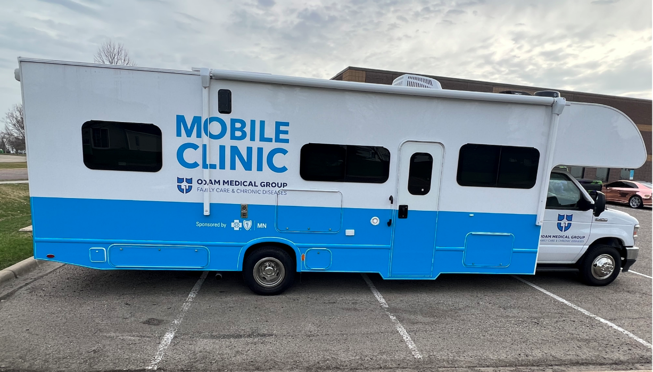
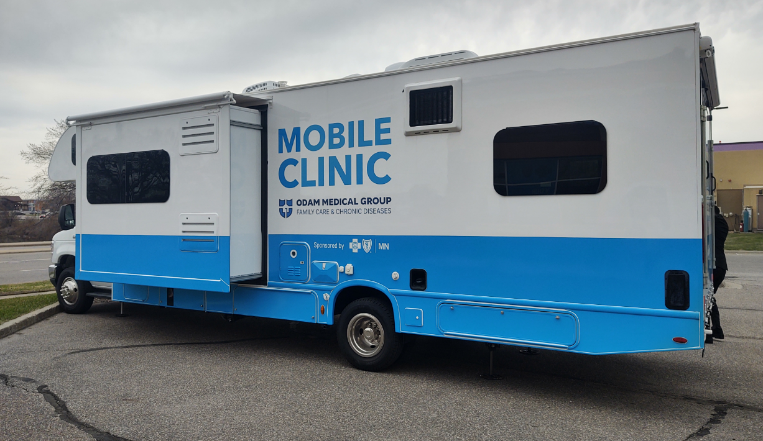
odAM MOBILE CLINIC
The Odam Medical Group Mobile Clinic program launched May 2022 to bring healthcare to populations in medically underserved communities in rural Minnesota with the following goals:
Increase access to culturally-concordant care in rural community settings for Blue Plus members and medically under-served populations.
Eliminate barriers to physical access to care: transportation, work schedule, office hours, childcare, lack of culturally-concordant providers.
Close gaps in care for key HEDIS measures

Slide 4
Patient experience
Patient needs to see doctor
Odam Medical Group schedules appointment for patient’s home
Doctor prescribes follow up treatment or referral to specialist
Medical assistance reviews care plan & conducts satisfaction survey
Community Health Worker assesses patient for SDOH needs and gaps; makes referral to resources
Doctor treats patient in exam room
Patient calls Odam Medical Group
Mobile clinic hits the road
Odam Medical Group follows-up with patient
Patient prescribes treatment or referral to specialist
Medical assistant reviews care plan with patient and next steps
Odam Medical Group follows-up with patient

Slide 5
2024 PROGRAM ENHANCEMENTS
SUD Treatment Service
BH Nurse Practitioner | Medical Assistant | Community Health Worker
Mobile Mammogram Unit
Mammogram Technician | Medical Assistant | Community Health Worker
Bone Density Screening
Mobile clinic operations
3 days/week
Go Live – TBD on staff hired
Collaborate with SUD-focused community partners, local hospitals and county public health in their service area to provide inpatient SUD services
3 days/week
Go Live – June/July 2024
Collaborate with senior-focused community partners and county public health to conduct community pop-up mammogram clinics.
Coordinate transportation with Blue Ride for Blue Plus members who live outside the service area
5 days/week
Go-Live – TBD upon delivery of bone density screening machine
Offer to all MSHO female members at time of service
Host at least 2-4 bone community density screening pop-up clinics/year (can be combined with mammograms)
Coordinate transportation with Blue Ride for Blue Plus members who live outside the service area

Slide 6
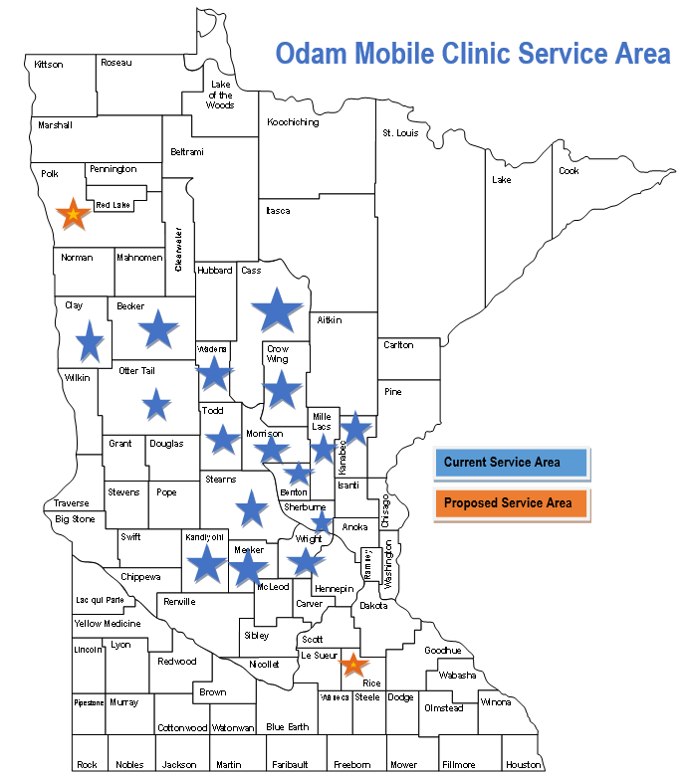
2024 program enhancements
First Response Services
Mobile clinic operations
Outpatient Primary Care Services
Mobile clinic operations
Service Area Expansion
Treatment of common life-threatening injuries and acute illnesses in patient home or other site of emergency
Follow up with patient post-service for check-ups and/or referrals to specialty providers.
7 days/week
Perform outpatient primary care in group homes, homeless shelters, assisted living senior homes and nursing homes
Odam will collaborate with senior-focused community partners, county public health and hospitals in their service area to treat seniors. Odam will follow up with patients post-service for check-ups and/or referrals to specialty providers.
5 days/week
Now serving Rice and Polk counties!

Slide 7
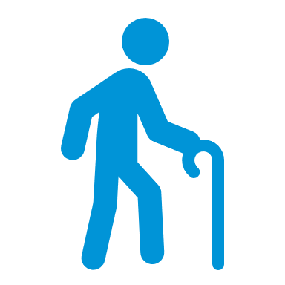
New Scope of services
Children
Well-child Assessment (WCV, W30, ADD)
Adults
Maternal Health
Seniors
Fall risk assessments
General health assessment
Immunizations (CIS, IMA)
Dental sealant application
Childhood asthma management (AMR)
Weight, height, vital signs
Screenings, including vision, hearing, blood lead level
Pap smears and other routine screenings (CCS, CHS)
Administration of appropriate vaccines or other eligible treatments identified during the assessment and screening
Senior immunizations
Medication management
Pregnancy testing
Prenatal care
Postpartum care (PPC)
Mammograms (BCS)
Bone Density Screening (AWR)
Mammograms (BCS)
All Ages
Diabetes testing and management, including foot care (HBD, KED)
Weight management (WCC)
Testing and treatment of hypertension (BPD, CBP)
SDOH screening & referrals
Behavioral health evaluation and referrals
SUD treatment
First response services
Outpatient primary care services

Slide 8
FA Q’s
How many languages can the Odam Medical Group accommodate in the mobile clinic?
The mobile clinic team speaks Somali, Spanish, Swahili, Hmong, Vietnamese, English. They have recently added Pashto, Dari and Urdu through a contracted Afghani interpreter that can ride with the team. If other languages are needed, they connect virtually with interpreter agencies.
Who travels in the mobile clinic?
The mobile clinic team is comprised of a medical doctor, a nurse practitioner, medical assistant, community health worker and a driver.
How many patients can Odam Medical Group see each day in the Mobile Clinic?
Odam can see up to 10-20 patients each day (Wednesday, Thursday, Friday, Saturday, Sunday).
Does Odam conduct member surveys?
Yes. Odam conducts surveys via an iPad after the appointment to capture member satisfaction and other qualitative data. The survey was developed in collaboration with Odam.
Can Odam schedule stand-by appointments if their schedule is full?
Yes, if they are in the area and if there are cancellations. They will call patient/member if they can/cannot make it.
When did the mobile clinic begin operations?
The mobile clinic began operations in May 2022.

Slide 9
FAQs
How are follow-up visits handled after referrals?
When Odam Medical Group receives the consultation notes from member’s specialist, Odam will schedule appointment (on site, in clinic, or virtual) to review the consult notes with patient. Odam Medical Group ensures they understand what’s going on, explain results of tests, etc
What happens if a patient needs a specialist?
Odam Medical Group will appropriately refer a patient to a specialist based on the medical need or situation. They embed a list of specialists and specialty clinics in their electronic health records. Odam Medical Group mobile staff will schedule the appointment and ensure member has transportation and interpreter resources.
What happens if patient needs to be seen sooner than the mobile clinic can make it to their home?
Odam Medical Group will assess the medical need of patient with a virtual visit first. During this visit, the doctor or nurse practitioner will determine the best course of action. Examples include, but are not limited to, referring member to an urgent care near their home or helping them schedule an appointment with a specialist.
Is there a set schedule for when the mobile clinic will be in certain counties?
No. The Mobile Clinic is appointment-driven. While their service area is 18 counties, and they strive to be in each county each month, they only visit counties where appointments are scheduled. When members call for appointments, Odam will schedule them based on when and where other appointments are already scheduled. For example, if a member in Otter Tail county requests a mobile clinic visit, Odam will tell them when they are scheduled to be in Otter Tail county.
How can patients schedule a mobile clinic visit?
Patients can call Odam’s scheduling line at 612-260-1412 or at their St. Cloud office at 320-204-4270.

Slide 10
FAQs
What are the fees for home visits if patient does not have health insurance?
Whenever Odam sees an uninsured patient, they treat them first and then help them apply for MA insurance. If patient is approved, the MA insurance back dates 3 months so the visit will be covered by the new insurer. If the patient does not qualify for insurance because they make too much money, Odam explains that the fee for the service they receive from the mobile clinic is $75. The $75 covers all services performed by the mobile clinic.
Does the mobile clinic accept “walk-in” appointments when they are at a location?
Yes, if they have availability in their schedule. If they don’t, they will work with the patient to get a mobile clinic visit scheduled at their home.
What happens if the patient has a Commercial health plan?
For patients with commercial plans, Odam submits a claim to that insurer; the patients would pay their co-pay or cost-share at the time of visit.
How are copays (if applicable) handled at time of service?
Odam has a portable credit card machine that plugs into the mobile clinic's onboard wifi or data. They also accept cash. If patient has neither cash or credit card, Odam will email them a bill for the co-payment.
Is the mobile clinic wheelchair-accessible?
Yes. It is also walker- and stroller-friendly.
Will they go inside patients’ homes if the patient is unable to leave?
Their priority is not to go inside. But yes, they will enter a home if the patient gives them permission to go inside. The mobile unit is wheelchair accessible and they also carry a wheelchair onboard in the mobile unit.

