Slide 1
Care Coordination Advisory Group Follow up
Anita Sharma, Manager, Pharmacy Services
Stars, Quality, Risk Adjustment COE
11/30/23

Slide 2
We heard you!
Based on feedback provided at the care coordinator advisory committee, we’d like to talk through:
New 2024 pharmacy benefit changes
Review how members can find an in-network pharmacy
What is covered for diabetic supplies?
How to help new SecureBlue/MSHO members transition between diabetic supplies
Medication Therapy Management (MTM) services
Post-hospital discharge services to optimize medications
Information on the member experience measures influencing Star Ratings
Discussion on the new diabetes Performance Improvement Plan (PIP) for 2024

Slide 3
No significant changes in 2024
No significant changes to formulary or networks
Members will get a letter in the fall if any changes to the formulary will affect them - mostly changing tiers or quantity limits or adding prior authorization requirement
If a member needs to request an exception for any reason, this is called a Coverage Determination. This includes exceptions for formulary coverage, tiers, quantity limits, PA denial
Coverage determinations can be done via phone/fax, US mail or online. Instructions can be found on myprime.com here.
Link to the online form is here.

Slide 4
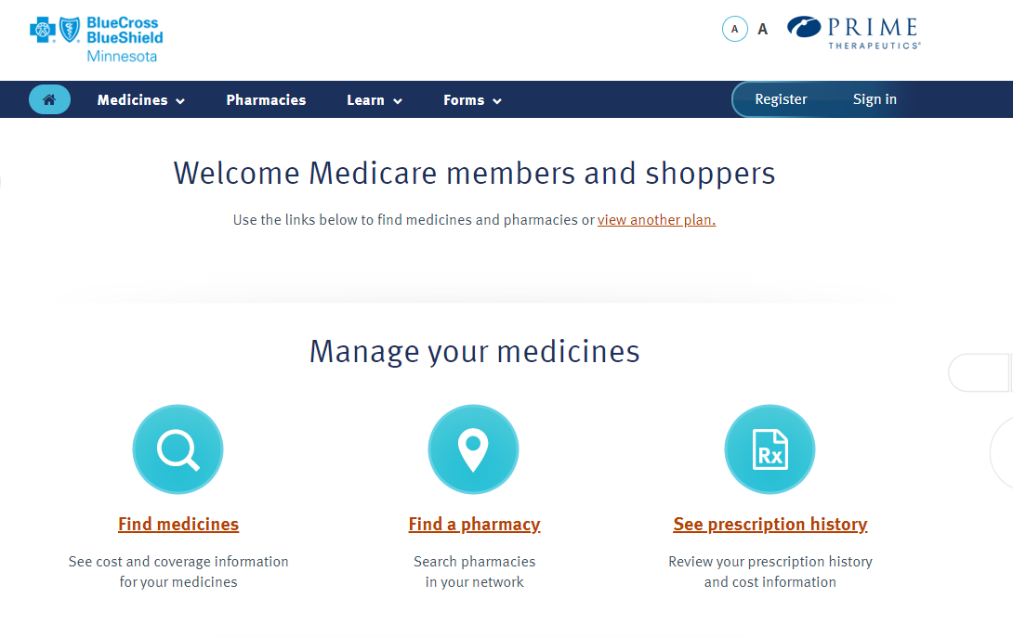
How to find in-network pharmacy
Myprime.com
or
Come in from Blue Cross online account (already signed in)

Slide 5
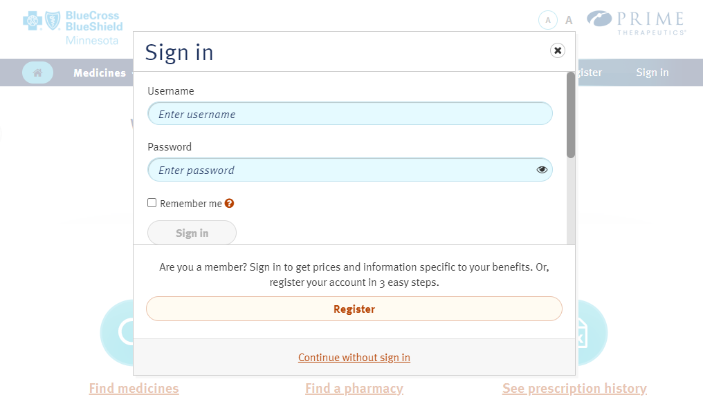
How to find in-network pharmacy
Come in from Blue Cross online account
Create or sign into your Prime account
Or
Continue without signing in

Slide 6
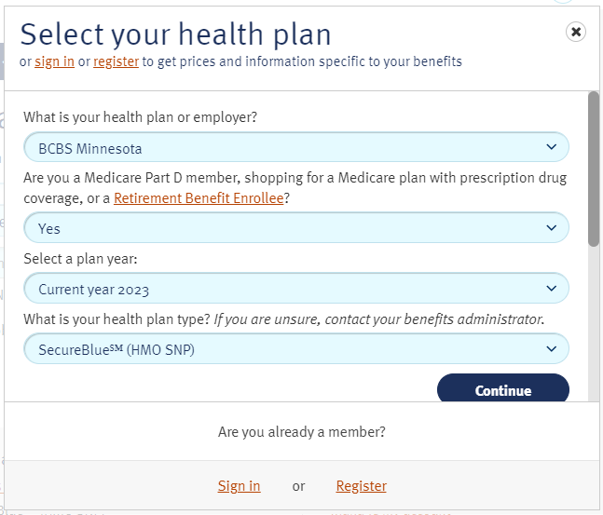
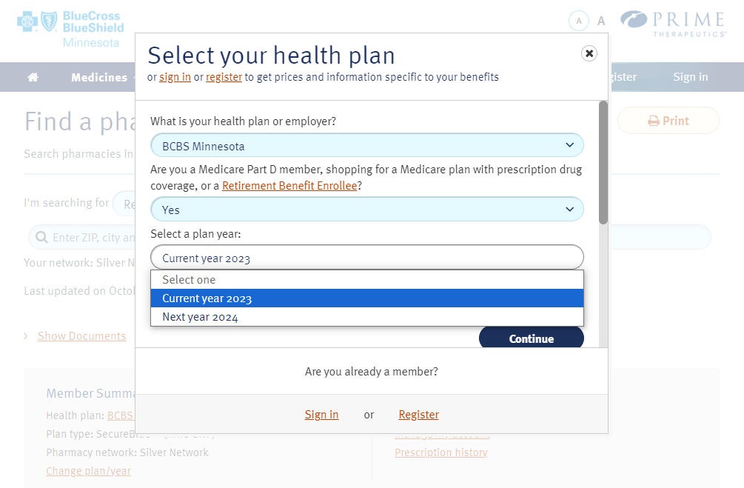
How to find in-network pharmacy
Make sure you’re on the right plan year (this choice only shows in the fall)

Slide 7
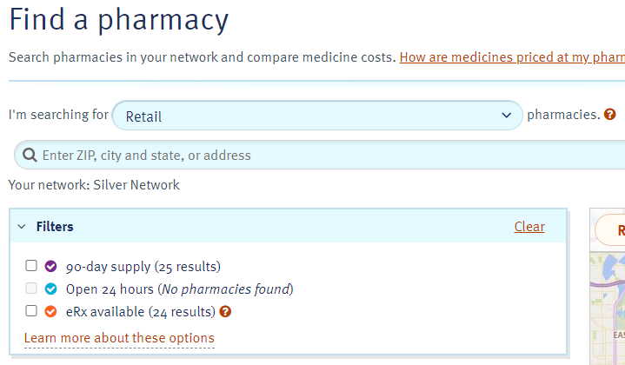
How to find in-network pharmacy
Select the type of pharmacy
Fill in location criteria
Any filters

Slide 8
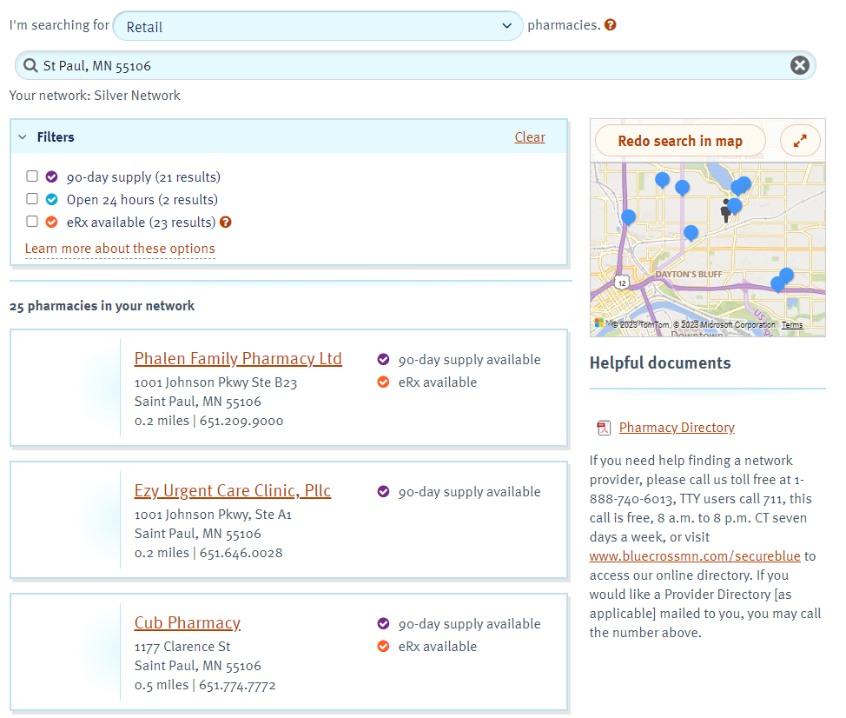
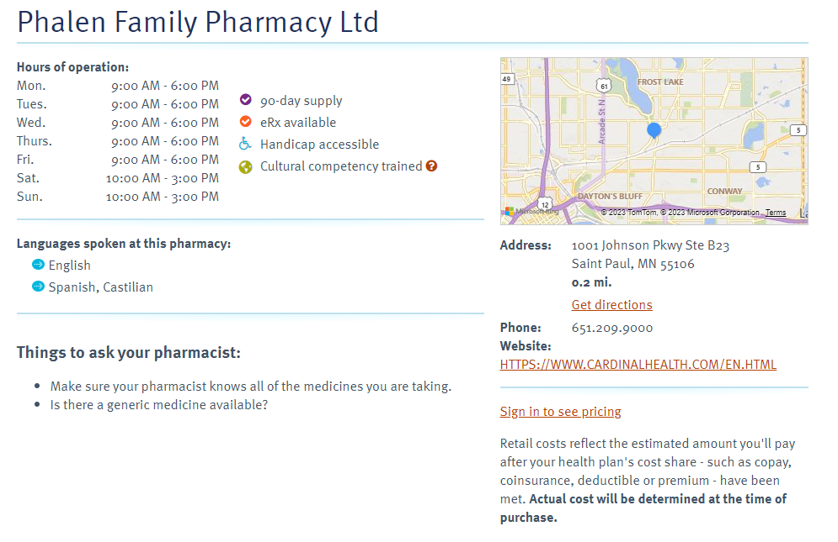
results

Slide 9
Diabetic supplies
What is covered for diabetic supplies?
- Lifescan (ex: OneTouch) and Ascensia brands (ex: Bayer, Contour)
Blood glucose monitor
Test strips
Lancet and lancet devices
Glucose-control solutions for checking the accuracy of test strips/monitor
The SecureBlue Handbook (page 63) lists the covered diabetes supplies
https://www.bluecrossmn.com/sites/default/files/DAM/2022-09/2023-secureblue-member-handbook.pdf
For people with diabetes who have severe diabetic foot disease:
One pair of therapeutic custom-molded shoes (including inserts) and two extra pairs of inserts each calendar year,
Or
One pair of depth shoes and three pairs of inserts each year (not including the non-customized removable inserts provided with such shoes) The plan will also pay for fitting the therapeutic custom-molded shoes or depth shoes.
Source copy goes here in 8 pt Arial

Slide 10
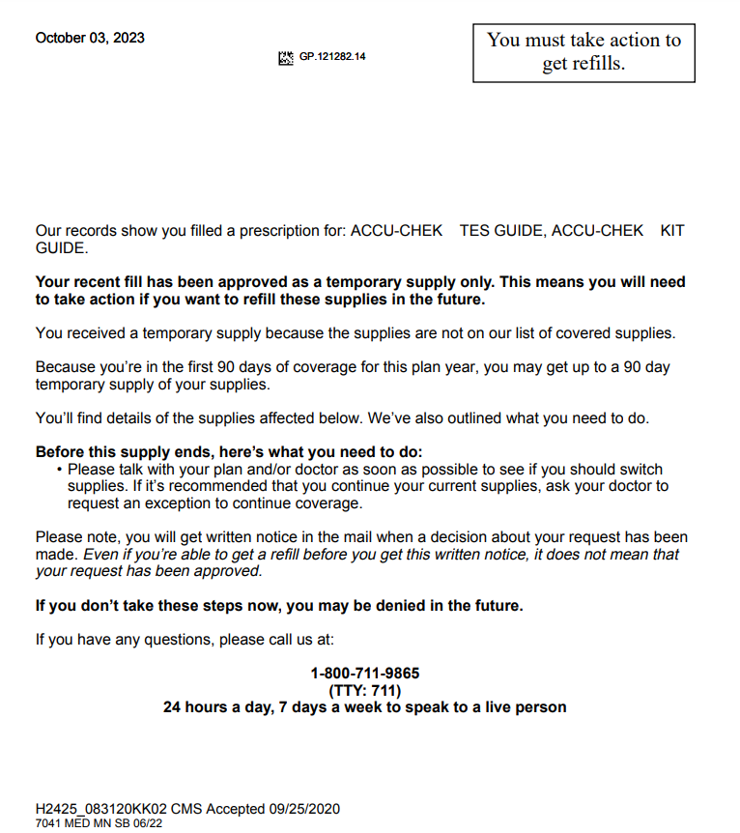
Diabetes Supplies
What happens if a member is newly enrolled and has a different machine?
If they have supplies, they can use until they run out. We allow for a transition period
An organization determination (Medicare Part B formulary exception) is required if they want to continue to use their current (uncovered) machine
Chapter 9 of the SecureBlue Member Handbook
Notes:
We do allow for a transition period when they are brand new to the plan – it will pay for the first time, transition messaging will go back to the pharmacy to let them know Lifescan and Ascensia are preferred. Letter also goes to the member

Slide 11
Medication Therapy Management (MTM) Services
Medication Therapy Management (MTM) is a set of patient centered services delivered by pharmacists that are designed to assess all individual’s medications for:
Appropriateness
Effectiveness
Safety
Ability to be taken as intended
MTM is also designed to:
Ensure optimum therapeutic outcomes by improving medication use
Reduce the risk of adverse events
Improve medication adherence
Available to all SecureBlue members at any time during the year, including post-hospital discharge
Leverage an external contracted network (care systems and community pharmacies) to delivery MTM services, along with an internal BCBSMN team
There is no cost to the member for any visits

Slide 12
Medication Therapy Management (MTM) Services
All SecureBlue members can receive MTM services without any cost. Certain members are targeted as part of the CMS requirements for MTM services
The pharmacist:
Employs a systematic process of collecting patient-specific information
Assesses medication therapies to identify medication related problems
Develops a prioritized list of medication related problems
Creates a plan to resolve them with the patient, caregiver to the patient, &/or the patient’s prescriber through follow-up visit(s)
Initial visits (Comprehensive Medication Reviews) are typically 60 minutes
Follow up visits (Targeted Medication Reviews) are typically 30 minutes

Slide 13
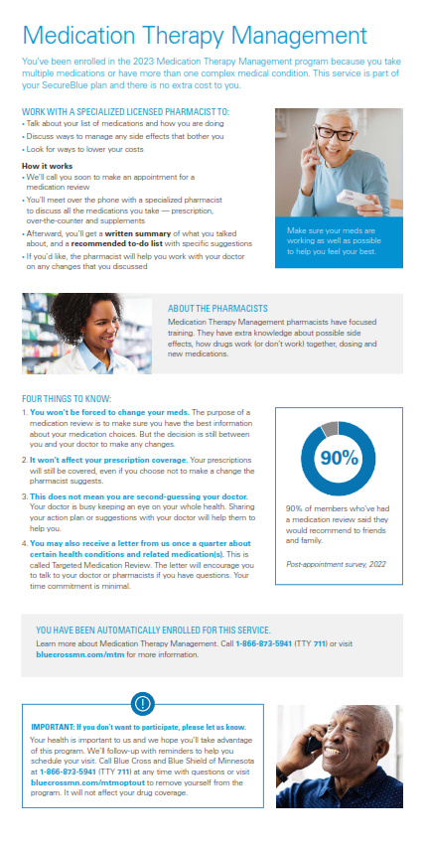
Medication therapy management (MTM) services
MTM services are designed to help members make sure they are getting the best possible health outcomes from their medications
No additional cost
Available to all SecureBlue members
Some members, who meet the criteria* are automatically enrolled in this program.
These members are part of the STAR measure rating
They will receive outreach - US mail, phone and email
Criteria: 3/5 specific chronic conditions, X number of medications for those conditions, and expected drug spend of $4100

Slide 14
Post Hospital Discharge Visits
Tabula Rasa will not be a supplemental benefit for members in 2024.
SecureBlue members can still work with a pharmacist to optimize their medications through MTM services.
MTM services will ensure that recommendations related to medication therapy problems are sent to the member’s provider and will also allow members to follow up with the pharmacist (not a one-time visit only).

Slide 15
What is CAHPS and why does it matter?

Slide 16
Member experience impacts our star ratings
CAHPS Basics
CMS measures member experience via the CAHPS survey;
CAHPS = Consumer Assessment of Healthcare Providers & Systems
Annual mandatory survey;
Direct mail with phone follow-up;
In the field each year March – June
Blinded: CMS requires that the survey is administered by an approved third-party vendor and that member responses are kept anonymous
BCBSMN does not know which members were part of the sample and/or how each member responded to the CAHPS questions and why;
CAHPS metrics are quadruple-weighted for the coming year
8 CAHPS Metrics | Metric type
Rating of Health Plan (RHP) | Health Plan Measures
Rating of Drug Plan (RDP)
Customer Service (CS)
Overall Health Care Quality (RHC) | Care System Measures
Getting Needed Care (GNC)
Getting Care Quickly (GCQ)
Coordination of Health Care (CC)
Getting Need Prescription Drugs (GNPD)

Slide 17
2023 MSHO CAHPS Results = 2024 Star Ratings
Metric |  | Mean Score | CMS Official 2023 Rating | CMS Official 2024 Rating | Change from 2023 to 2024
Rating of Health Plan (RHP) | Health Plan Measures | 88 | 4 | 4 | 0
Rating of Drug Plan (RDP) |  | 87 | 4 | 4 | 0
Customer Service (CS) |  | 90 | 5 | 4 | -1
Overall Health Care Quality (RHC) | Care System Measures | 87 | 4 | 4 | 0
Getting Needed Care (GNC) |  | 82 | 4 | 4 | 0
Getting Care Quickly (GCQ) |  | 80 | 5 | 5 | 0
Coordination of Health Care (CC) |  | 87 | 5 | 4 | -1
Getting Need Prescription Drugs (GNPD) |  | 90 | 3 | 4 | +1

Slide 18
Q1 2024 Focus
Metric |  | 2023 Mean Score | CMS Official 2023 Rating | CMS Official 2024 Rating | Change from 2023 to 2024
Rating of Health Plan (RHP) | Health Plan Measures | 88 | 4 | 4 | 0
Rating of Drug Plan (RDP) |  | 87 | 4 | 4 | 0
Customer Service (CS) |  | 90 | 5 | 4 | -1
MSHO members who will receive a CAHPS survey between March and June of 2024 are likely to base their responses on their most recent experiences ➔ January – March 2024
The transition of all MSHO operations from AGP to BCBSMN will most likely encounter challenges;
It is important to work towards resolving any glitches quickly and smoothly to ensure the member has a positive experience;

Slide 19
CAHPS Metrics – Overall ACTIon plan
Metric | Type of Metric | What Can We Do? |  | MAPD | MSHO
Rating of Health Plan (RHP) | Health Plan Measures | Q2-Q3: | Annual Mock CAHPS | In progress for 2023/2024; Planned for 2024/2025 | Consider for 2024 / 2025
Rating of Drug Plan (RDP) |  | Q3-Q4: | Predictive Analysis
Customer Service (CS) |  | Q1 of following year | Targeted, meaningful outreach to selected member segments
Overall Health Care Quality (RHC) | Care System Measures | Use PEP data for performance measurement; Incentivize selected care systems via VBC agreements |  | Collaborate with Provider Relations / Contracting
Getting Needed Care (GNC)
Getting Care Quickly (GCQ)
Coordination of Health Care (CC)
Getting Need Prescription Drugs (GNPD)

Slide 20
Diabetes & Depression PIP
Performance Improvement Projects (PIPs) 2024-2026
Audrey Hansen, Program Manager, Senior, Healthy Start PIP

Slide 21
Current Blue Plus levers to influence identified barriers
Focused on individual plan performance on measures
Member Outreach
Community Partnership
Provider Partnership
Use digital platform for referral/connection to SDOH resources
Care gap in care lists for care coordinators
Identify and engage high risk members in case management
Care coordinator annual trainings
Value Based Care Contracting
Targeted member outreach regarding gaps in care
Care Management Program engagement
Home-delivered meals
In-home test kits
MTM (medication therapy management)
Notes:
These are the various levers

Slide 22
Planning for New pip projects – from 2024 - 2026
Diabetes & Depression
MSHO/MSC+ Members
Goal: Improve the racial and ethnic disparity gaps in members with diabetes and depression, for controlling high blood pressure in diabetes and HbA1c in control with year over year improvement in performance.
Outcome Measures:
Blood pressure control - patients with diabetes (BPD)
Hemoglobin A1c control - patients with diabetes (HBD)
NEW Community Informed Measures
Initiatives/Interventions:
To Continue (with added focus on members with both Diabetes and Depression)
Member outreach and communication
Care coordination education/training and sharing member gap lists
Member assessments, care management, MTM services
Value based care contract
NEW
Community Partnerships to focus on Diabetes and depression (Hue-Man, NAMI, MACMHP)
Medical Management process is currently being redesigned

Slide 23
Discussion questions
What type of webinar education would enhance your ability to serve this population with both diabetes and depression?
In your experience, what do you see/hear from this population that are barriers to receiving needed care?
Our understanding is that you may not be using a PHQ-9 but that you do conduct a depression screen of some kind to identify members with co-existing conditions, correct?

Slide 24
Questions?
Anita Sharma: Anita.Sharma@bluecrossmn.com
Audrey Hansen: Audrey.Hansen@bluecrossmn.com

